Slide 1
Alternatives to gambling
Mount Gambier & Goolwa trials

Slide 2
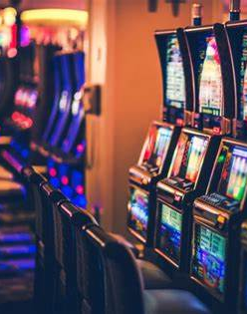
Project Background
Key project in Investment Plan
South Australians lost more than $1 billion on electronic gaming machines in 2024-25
Risk factors include social isolation, boredom and loneliness

Slide 3
Project aims
Reduce social isolation, loneliness and boredom
1
Build community connections
2
diversify leisure activities
less reliance on gambling
3

Slide 4
Step 1: Select locations & target group
regional areas with high EGM losses
people aged 50+
experiencing social isolation, loneliness, boredom

Slide 5
Step 2: Community consultation
Questions: activities, time & location, barriers to attending
Survey N = 166
21% play poker machines
28% socially isolated/lonely
43% do not participate in activities in their community
Small reference groups
in-depth discussions

Slide 6
Discussion
What we learned
Recreational activities exist in the community:
  Mainly between 11am and 3pm
  Range from very specific (trail horse riding) to general (program of activities run at the community centre)
People are lonely, isolated, yet do not attend activities. Barriers:
  Unaware of activities on offer
  Reluctant to go alone
  Transport
  Mental health, social anxiety

Slide 7
So… alternatives to gambling is not a particular thing or a particular activity.
It is:
A safe space
Casual (eg drop-in centre)
Consistent, regular (days, times, location)
For:
Social connection
Networks, linkages
Trying new things
Passive company with incidental socialising

Slide 8
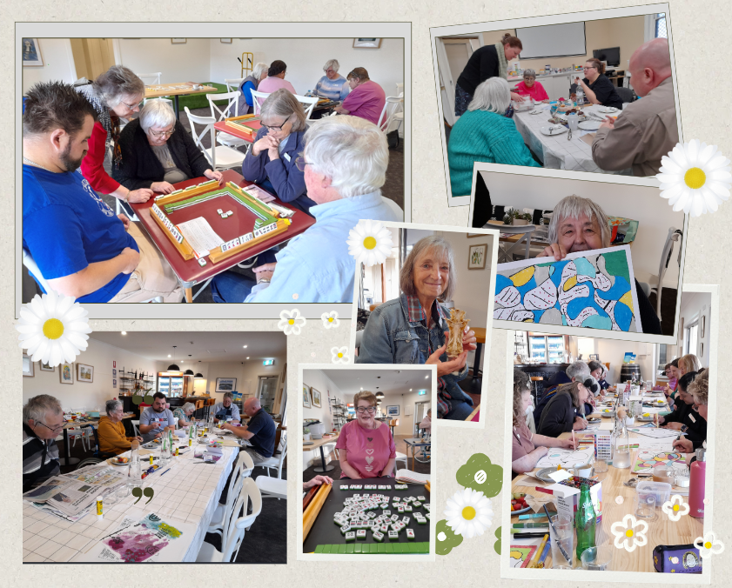
The Social Sprout

Slide 9
Data
Gambling type – most popular
33% Lottery/raffle/bingo
21% EGMs
Gambling behaviours
68% don’t gamble
32% do gamble
Social Sprout attendance feedback
99% Enjoyed the session
97% Felt more connected to community
85% Participant return rate

Slide 10
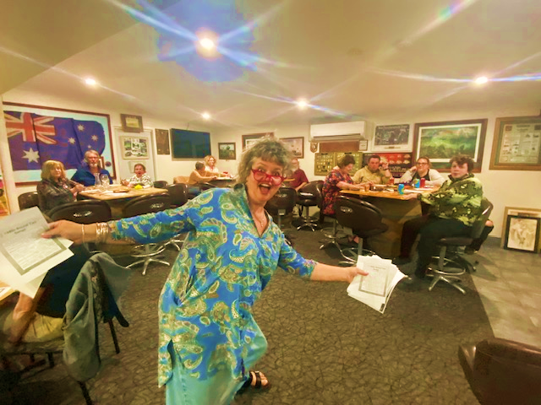

Social Set program
The
2024/2025

Slide 11
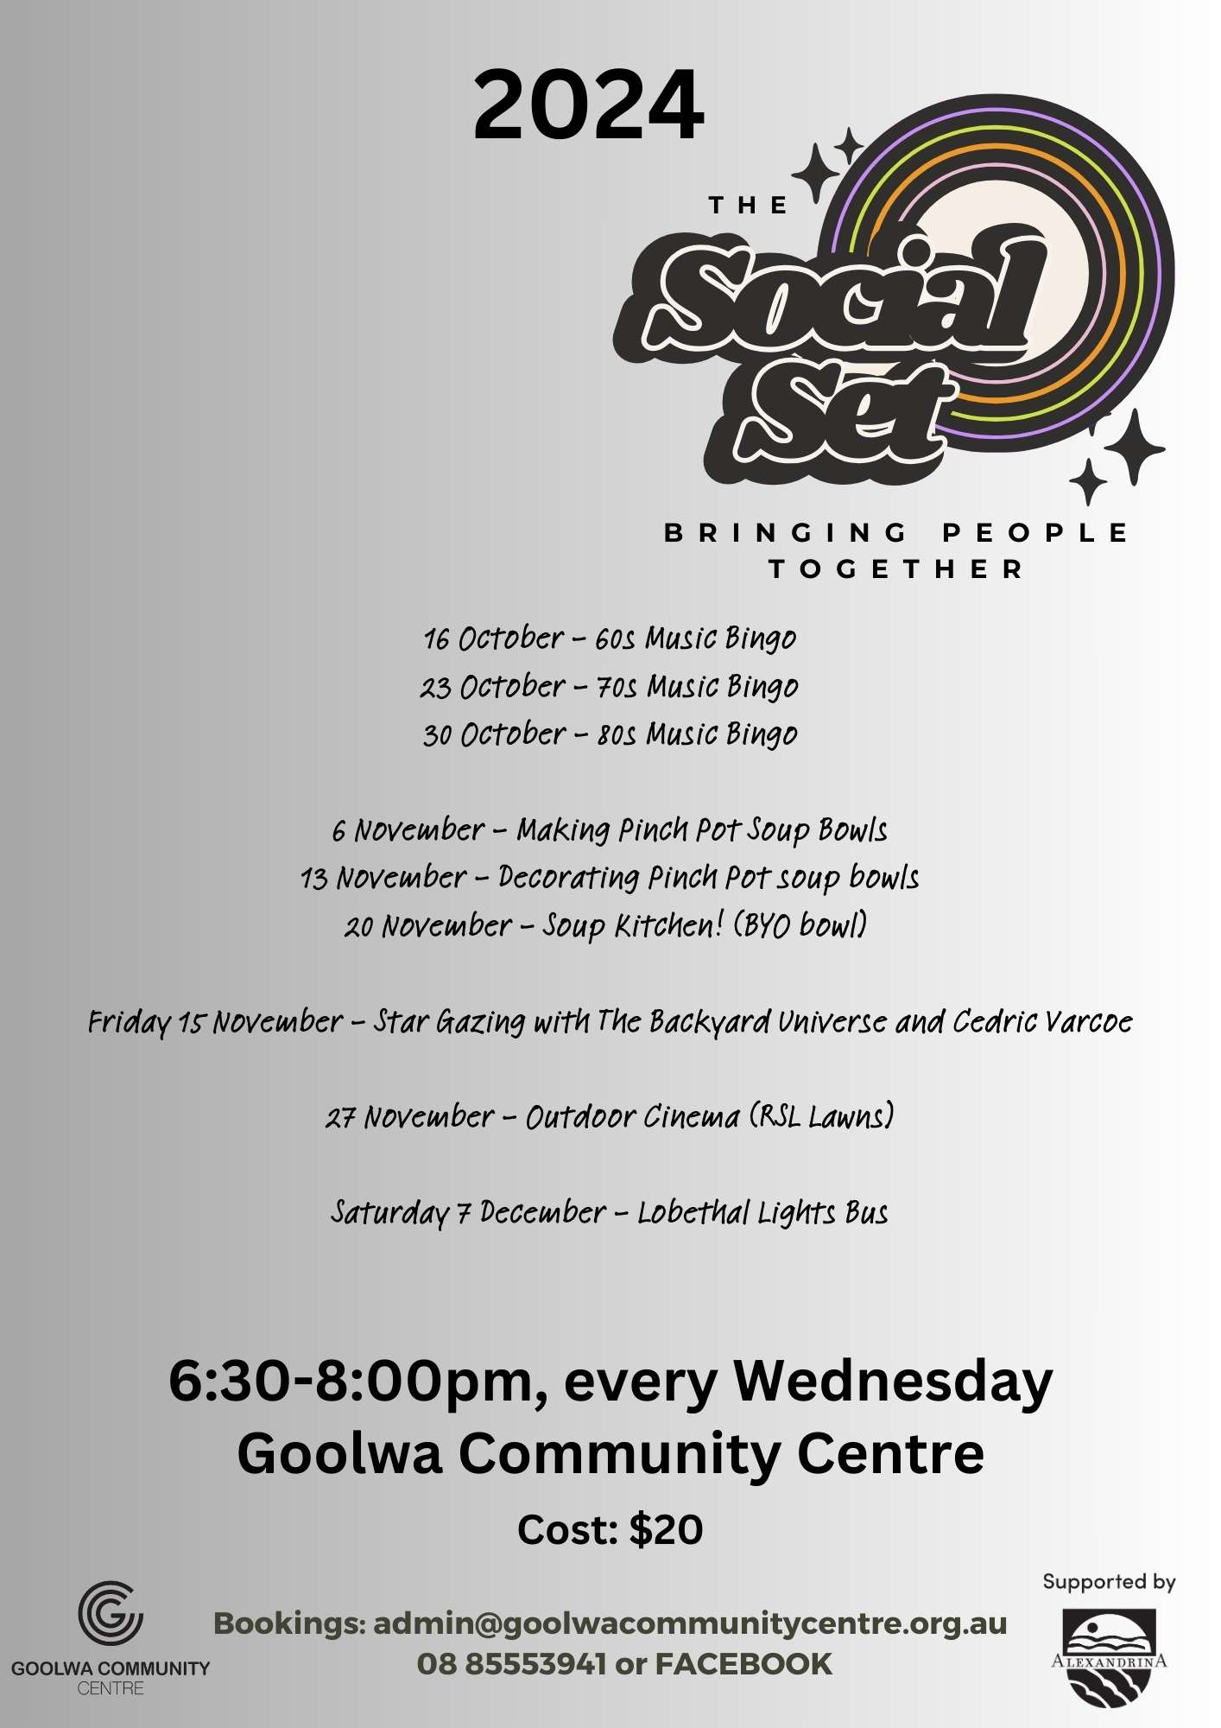
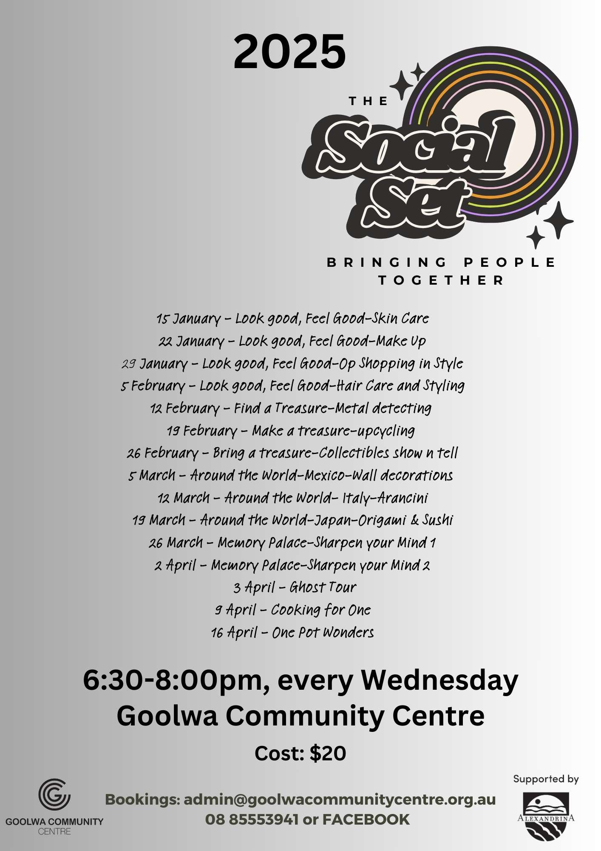
Social Set Program SCHEDULE
*Program Features
*Time Frame
*Entry
*Promotion
*Partnerships

Slide 12
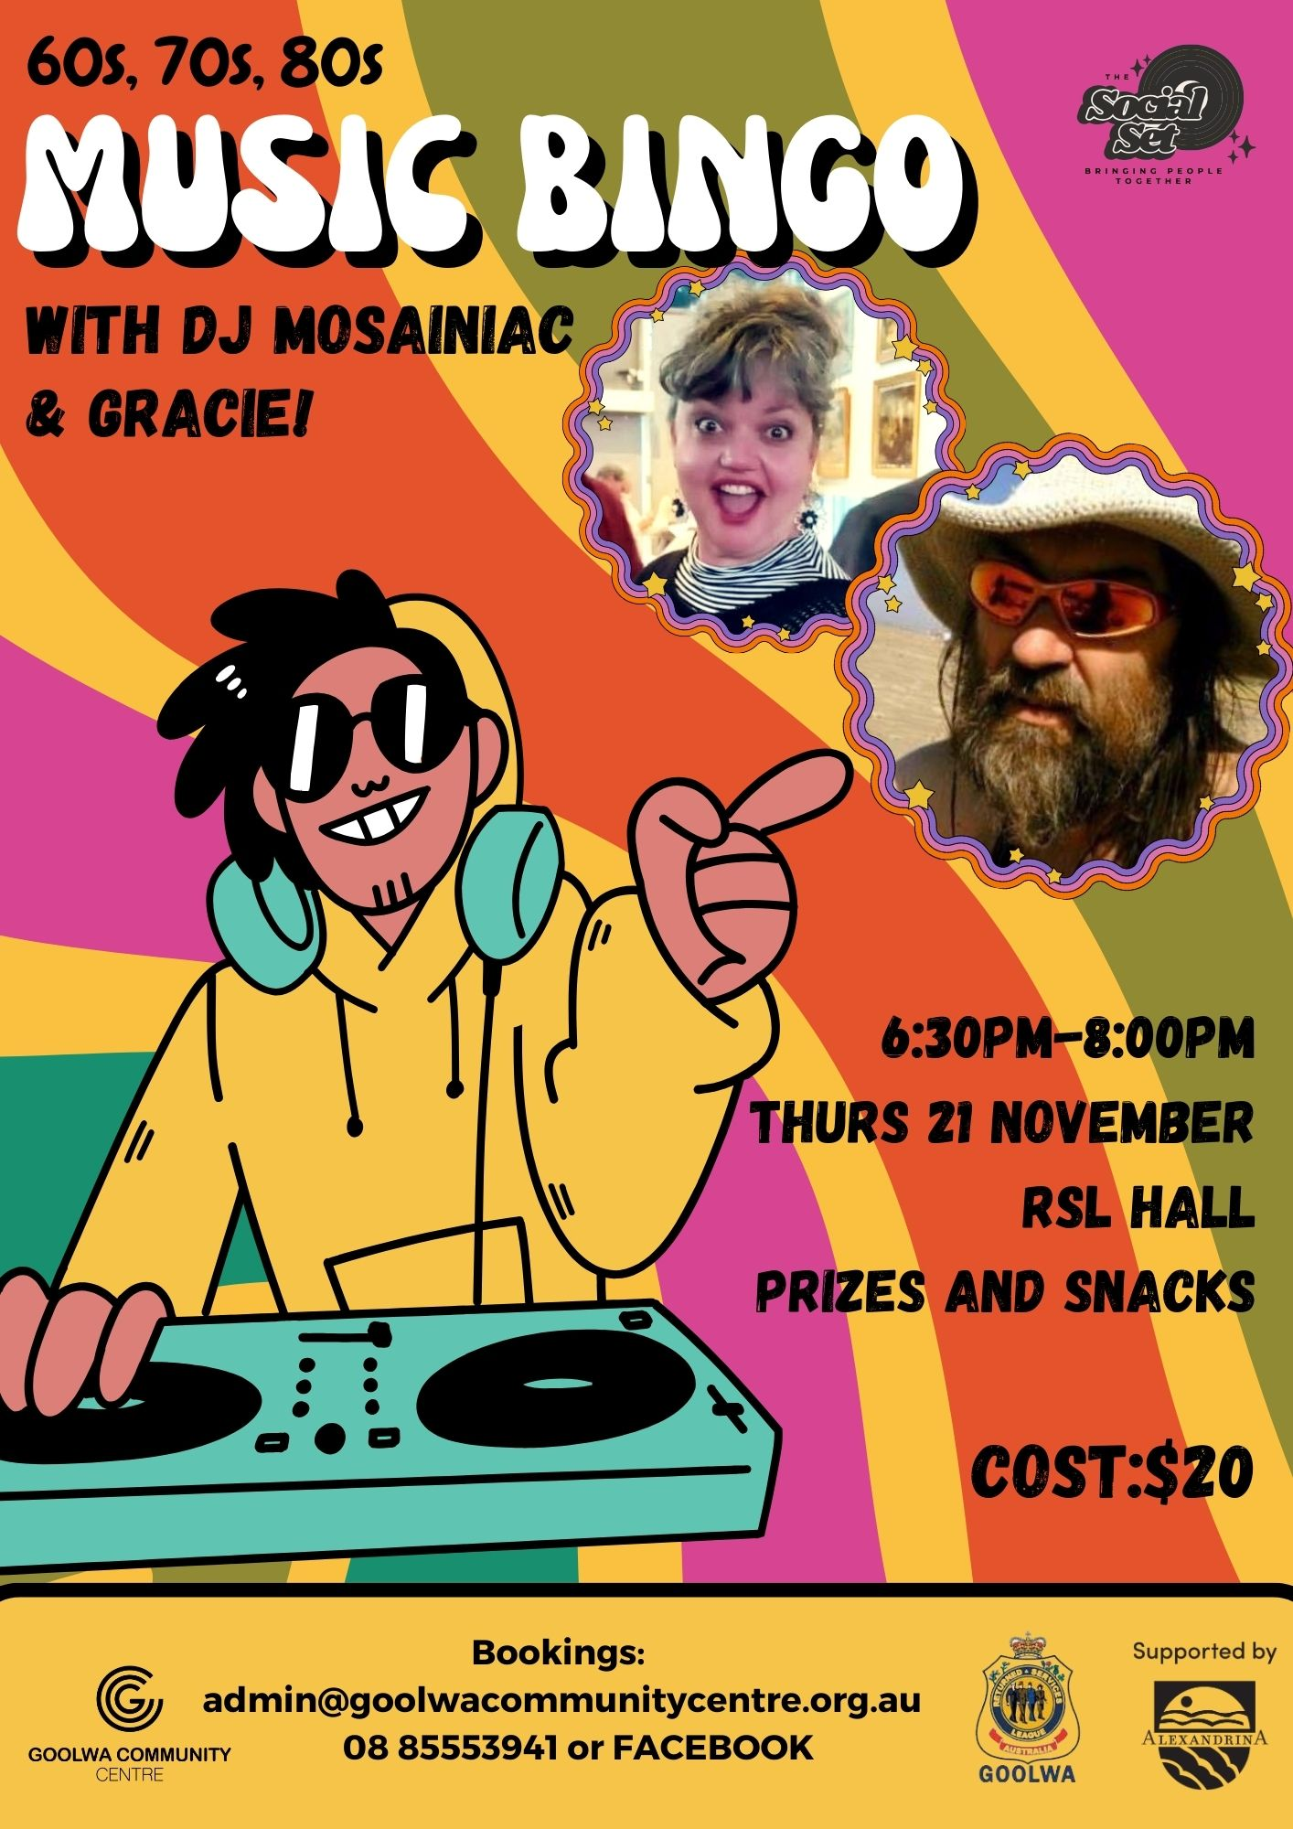
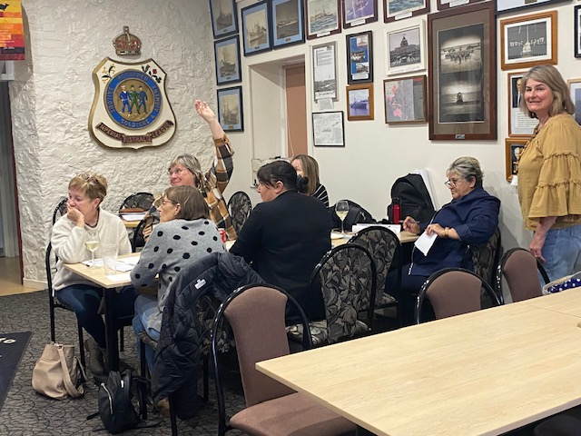

Slide 13

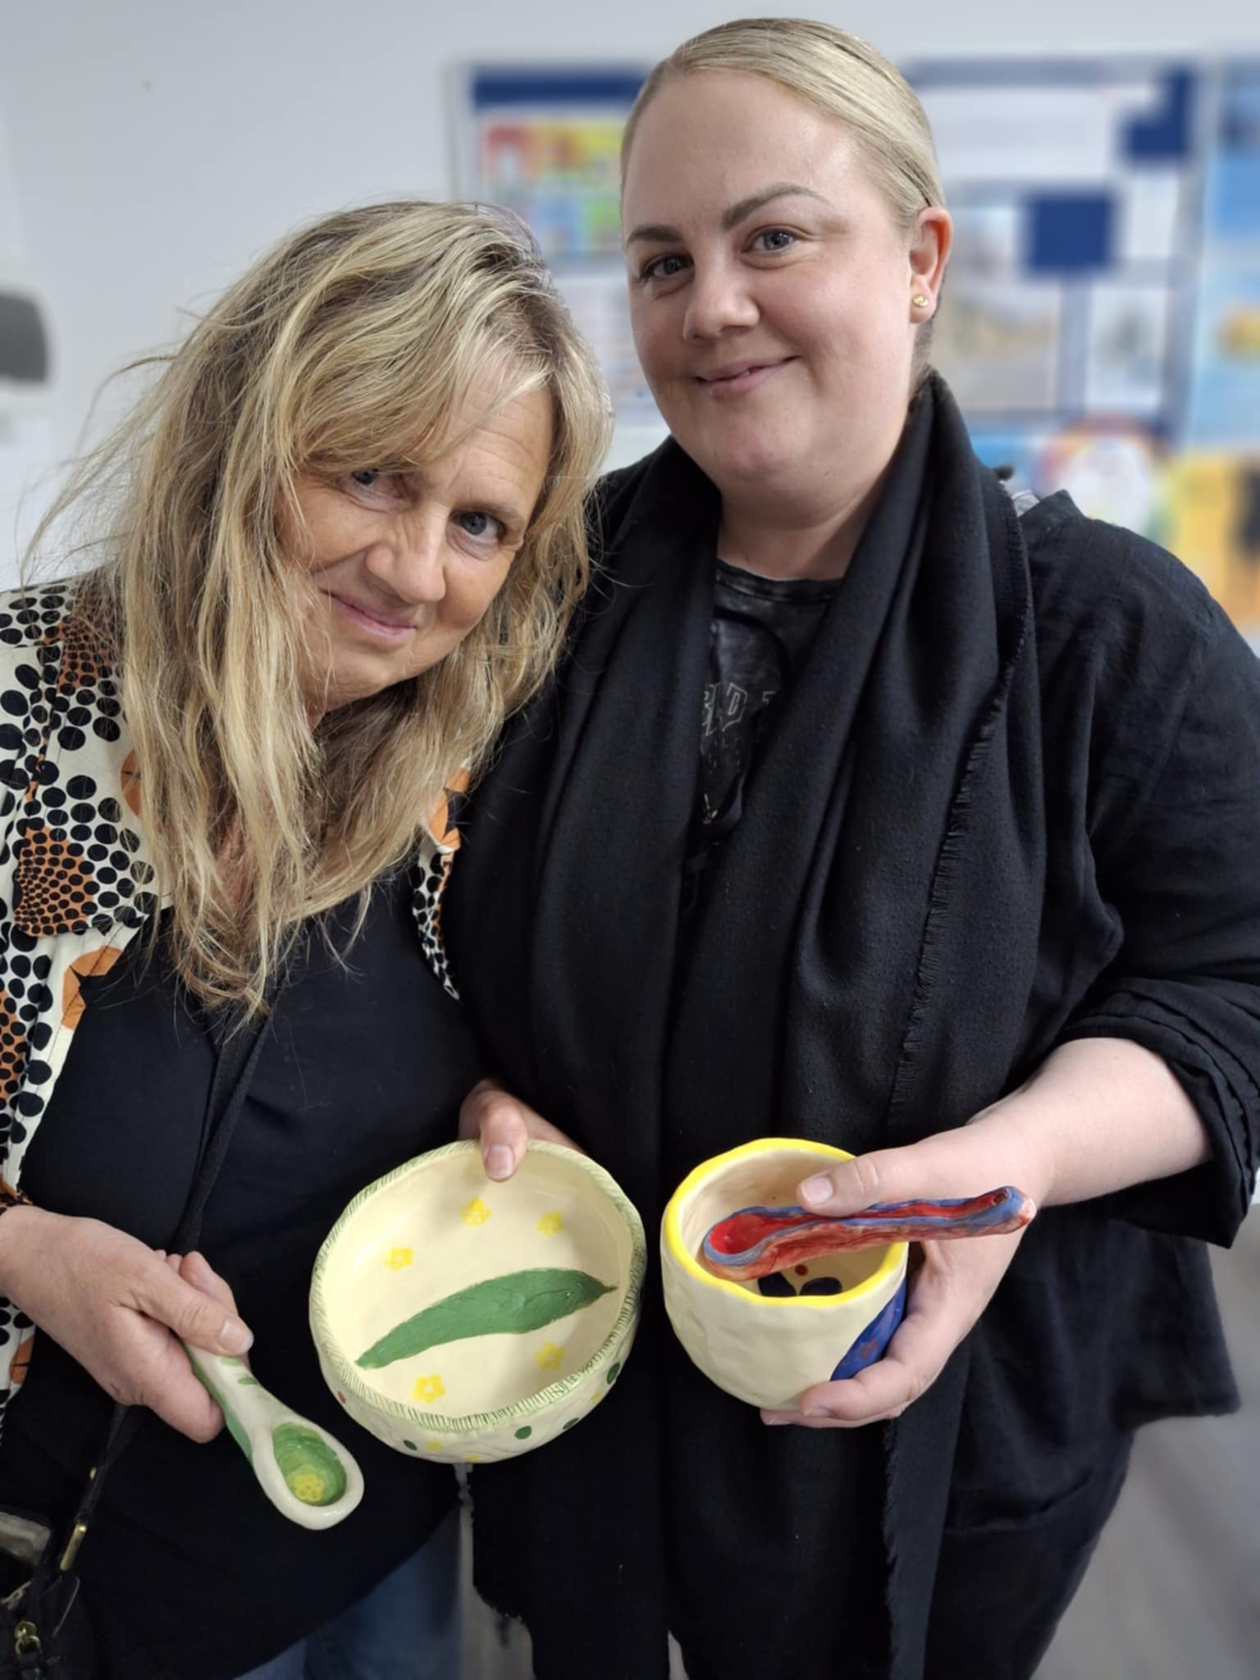

Slide 14
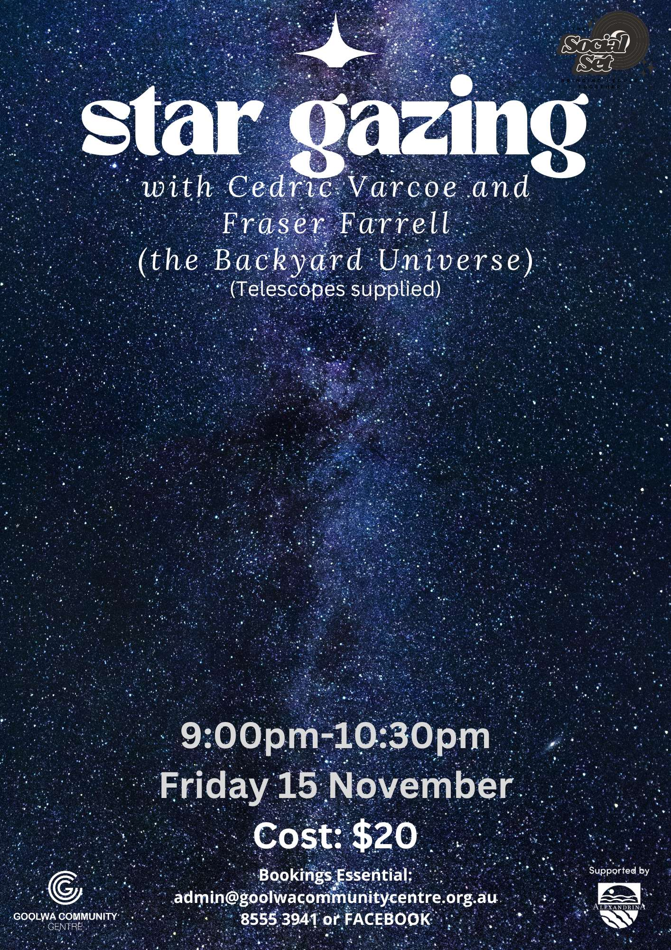
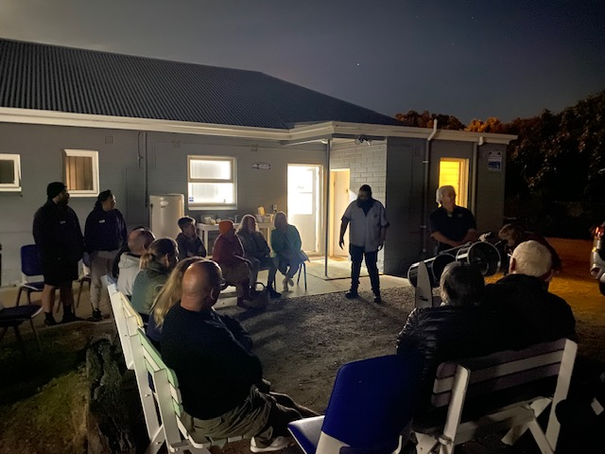

Slide 15
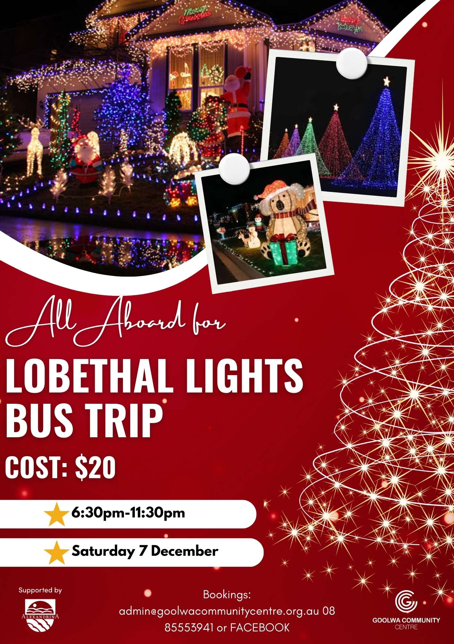
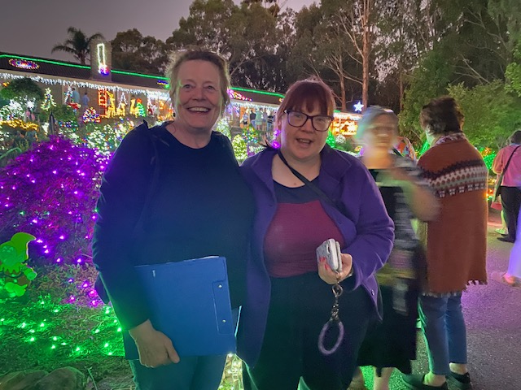

Slide 16

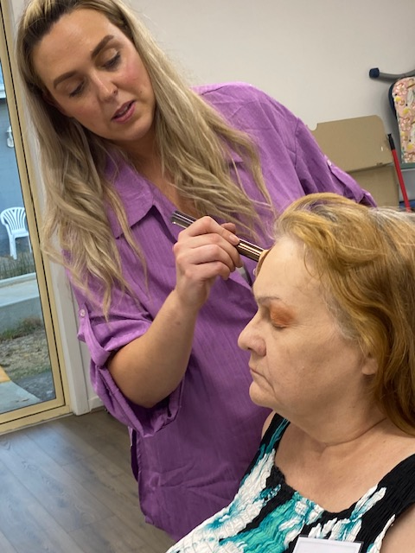

Slide 17

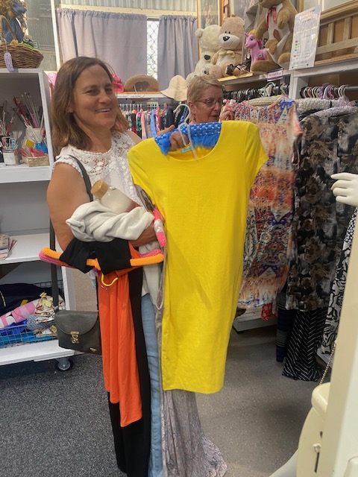

Slide 18
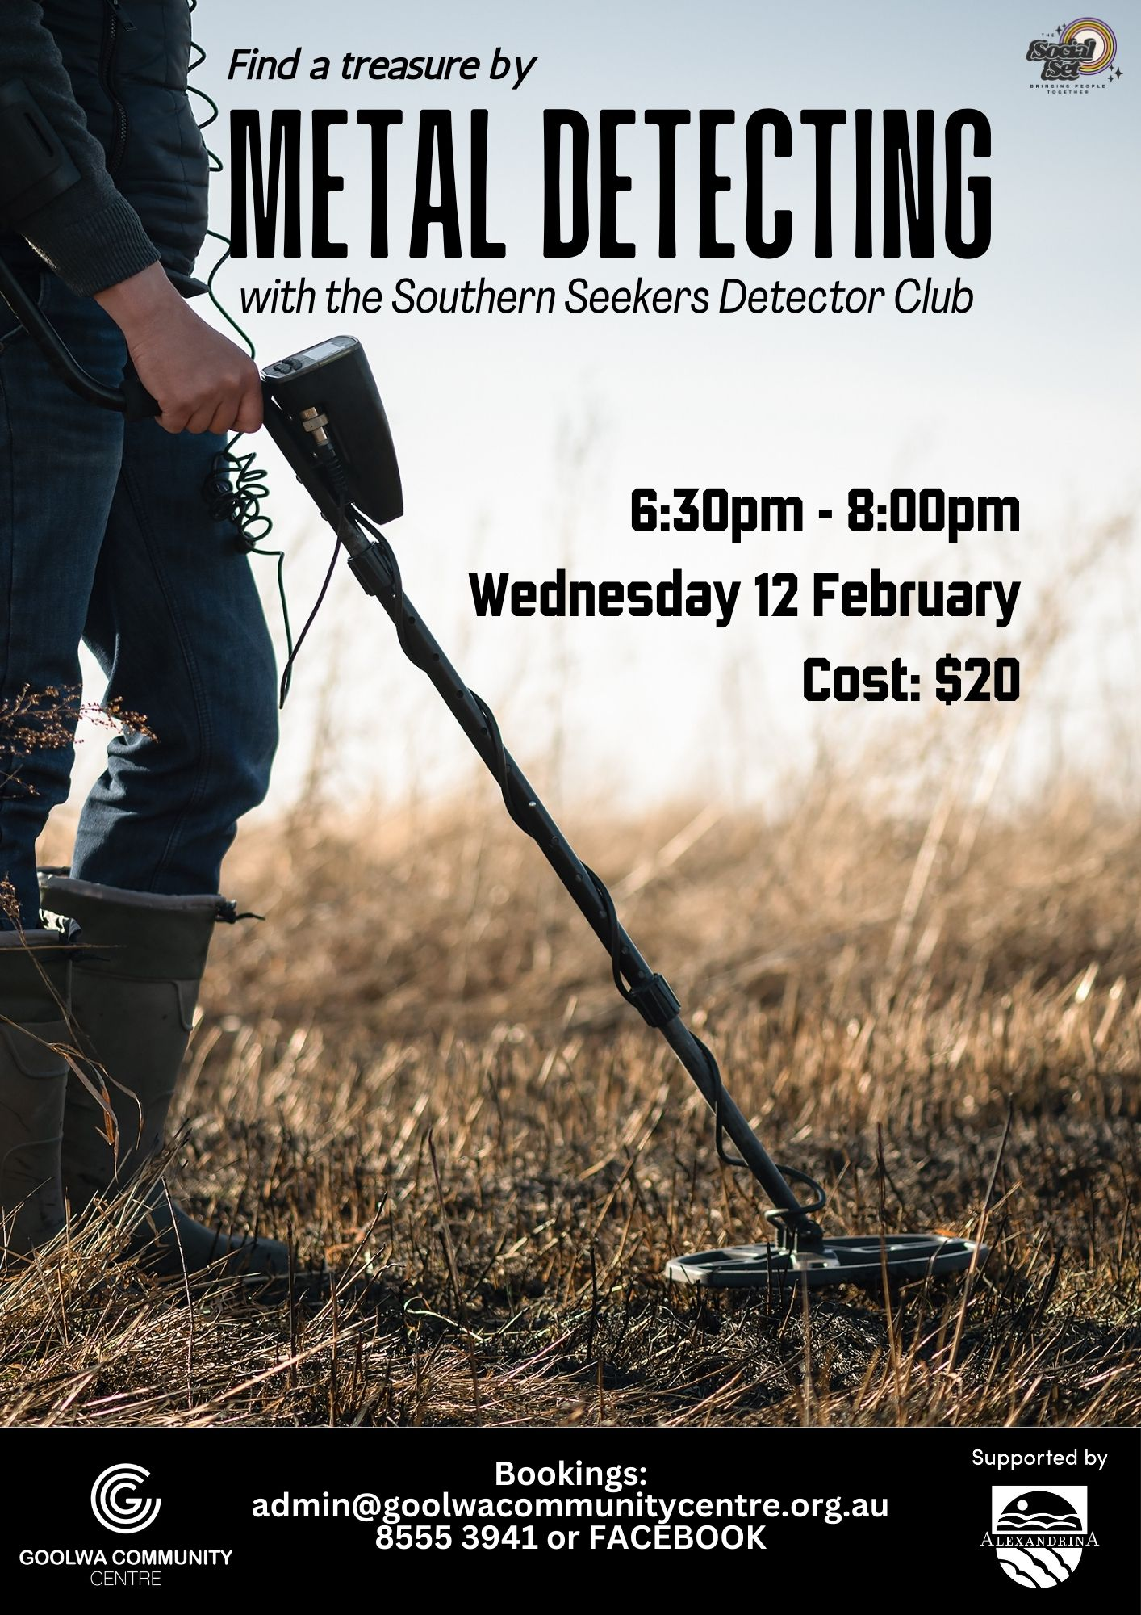
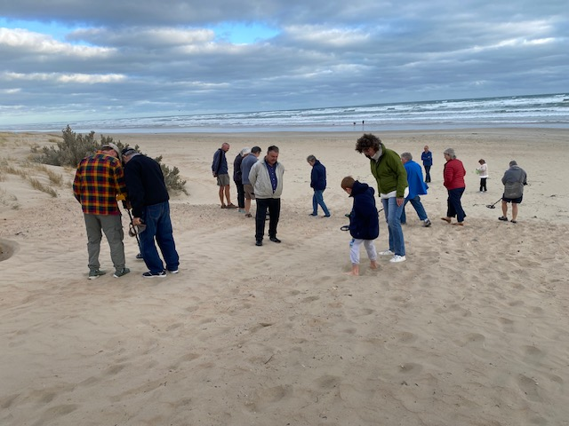

Slide 19

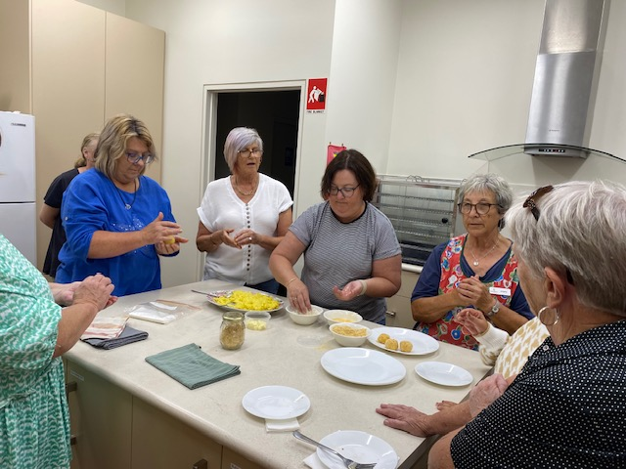
Italian cooking - Arancini

Slide 20

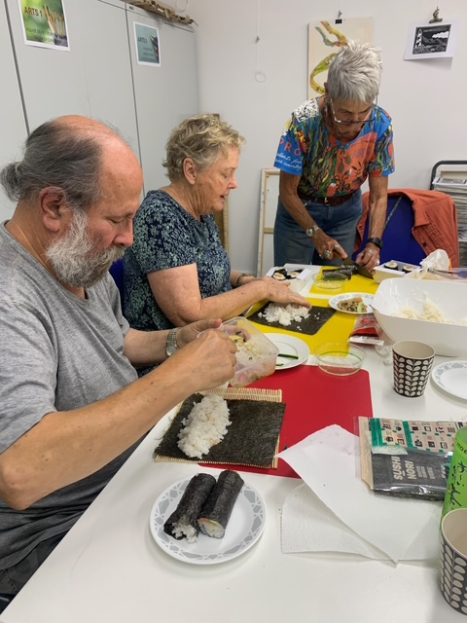

Slide 21
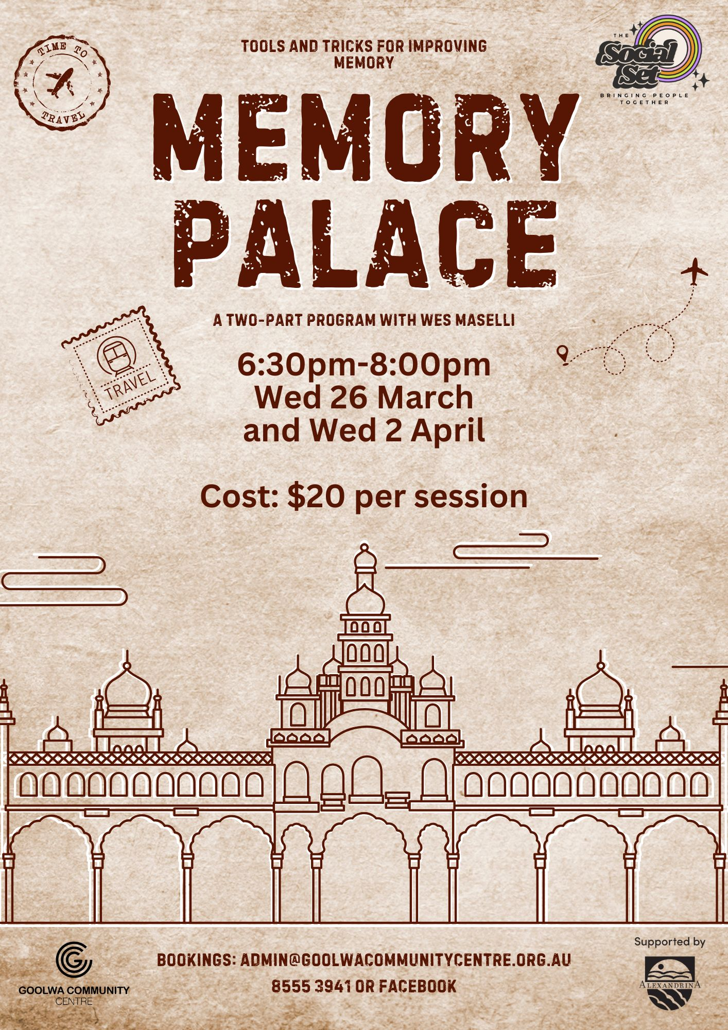
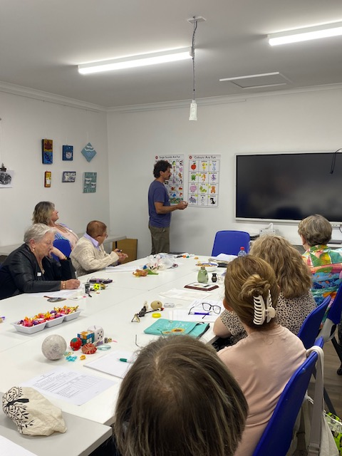

Slide 22
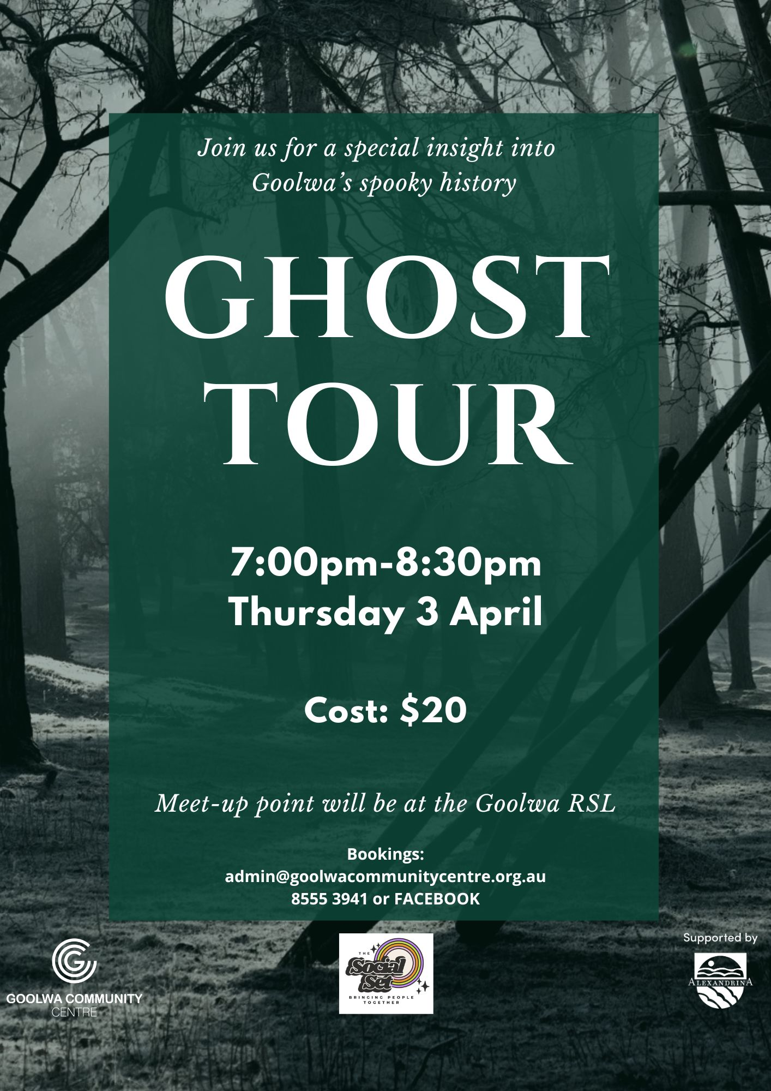
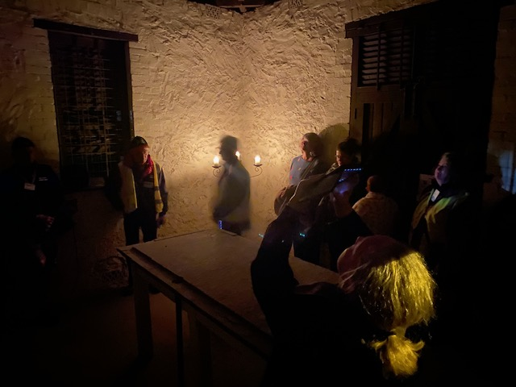

Slide 23
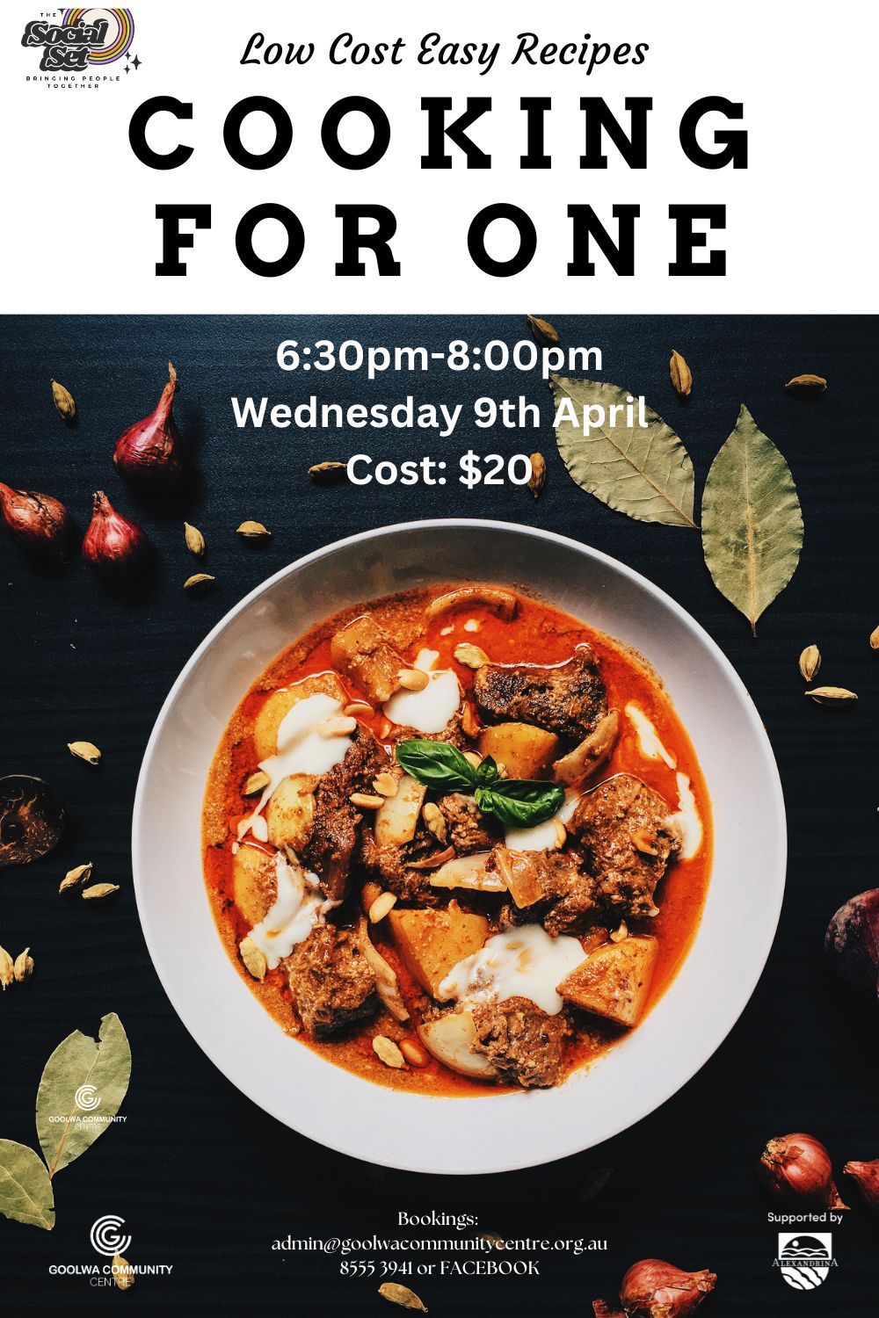
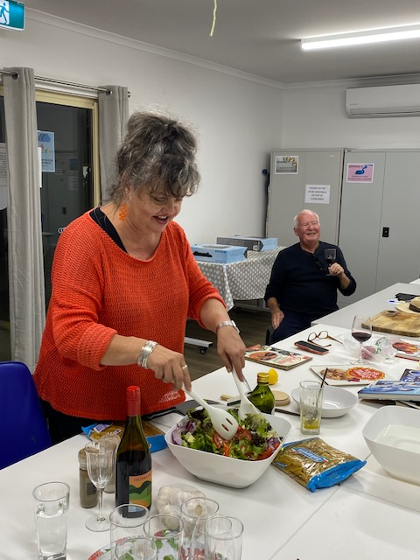

Slide 24
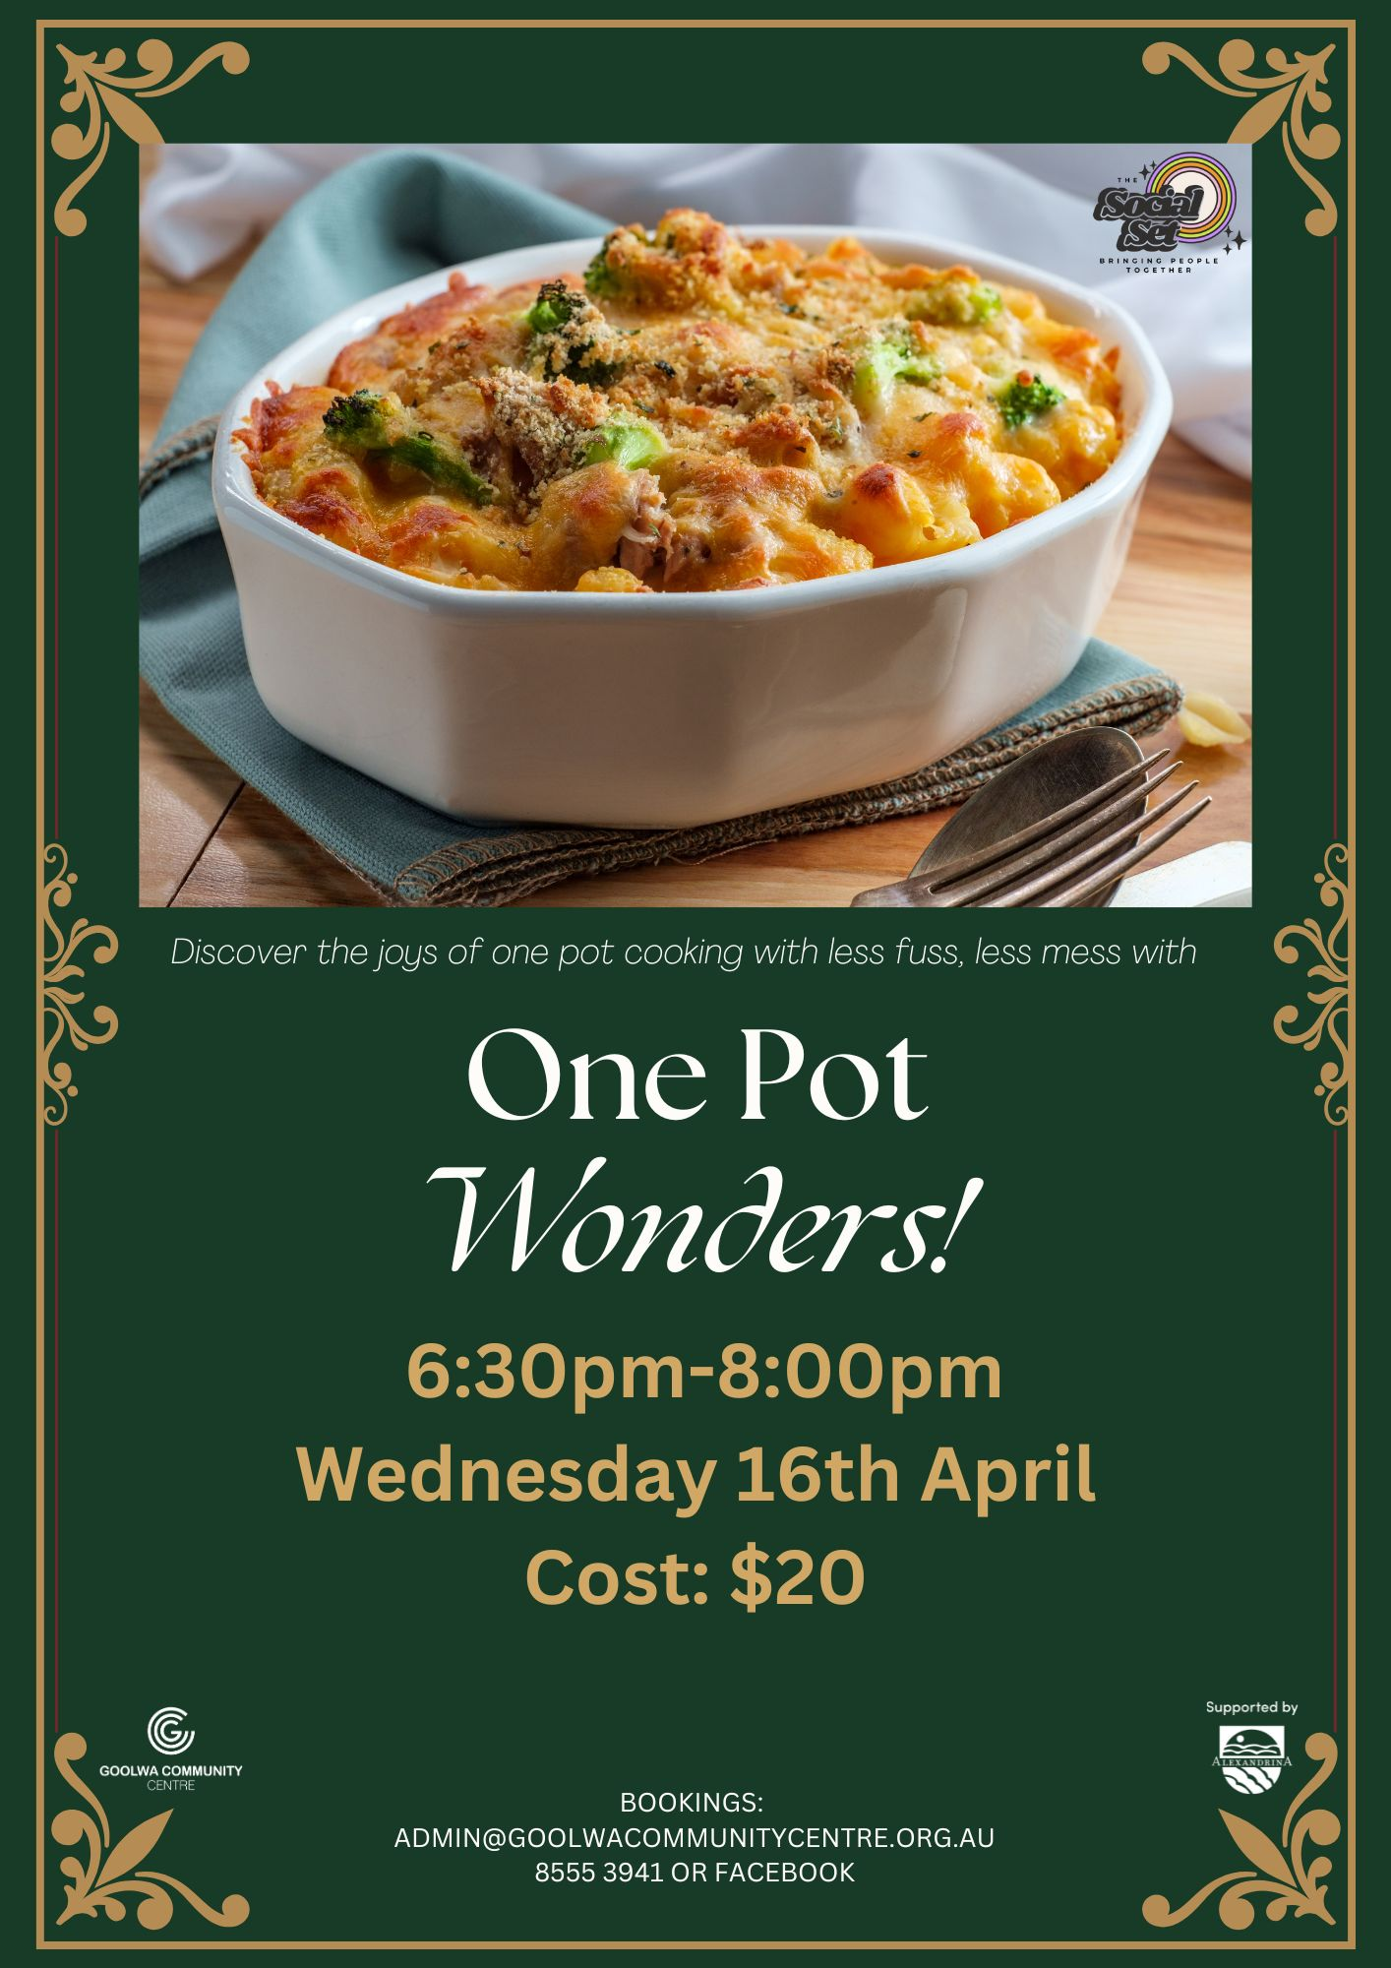
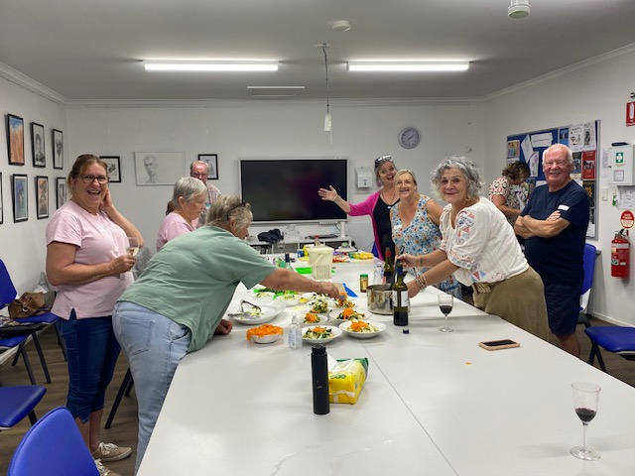

Slide 25
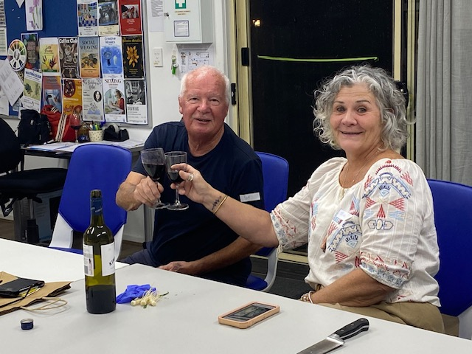
outcomes
290 people attended 19 sessions of the Social Set program (amounting to 861.5 hours of fun!) which provided a variety of opportunities for social connection, skills development and learning.
20% of survey respondees gambled regularly (once a week or more)
133 people attended the Goolwa Community Centre for the first time
98% of attendees reported feeling better connected to their community
One Pot Wonders
“Fabulous workshop.
Great facilitator and the social experience
was just so good.
Great to connect with people in my community.”

Slide 26
learnings
The Social set offered a diverse range of activities that brought people together to connect, learn new skills and develop a better understanding of their local community and environment.
At the beginning of each session, we talked about the program being offered as an alternative to gambling and the importance of social connection to health and wellbeing. We also spoke about the need to support neighbours, friends or other community members to get involved to overcome social isolation.
Social connection is a powerful tool in preventing addiction.
A connected community has the capacity to support those in need and provides a protective factor for people at risk.
The program offered activities not previously offered which brought 133 new faces to the Community Centre. It was deliberately scheduled for the warm summer evenings with extra daylight hours to entice people to join in.
In the next iteration of the program, each activity will be developed and run in partnership with Community Connections and other community organisations which builds the capacity and reach of the program and the message of gambling harm and prevention measures. The program will again be promoted through the hotels and clubs as well as partner agencies.

