Slide 1
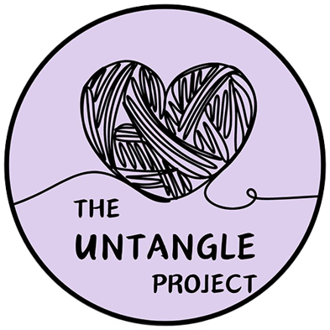
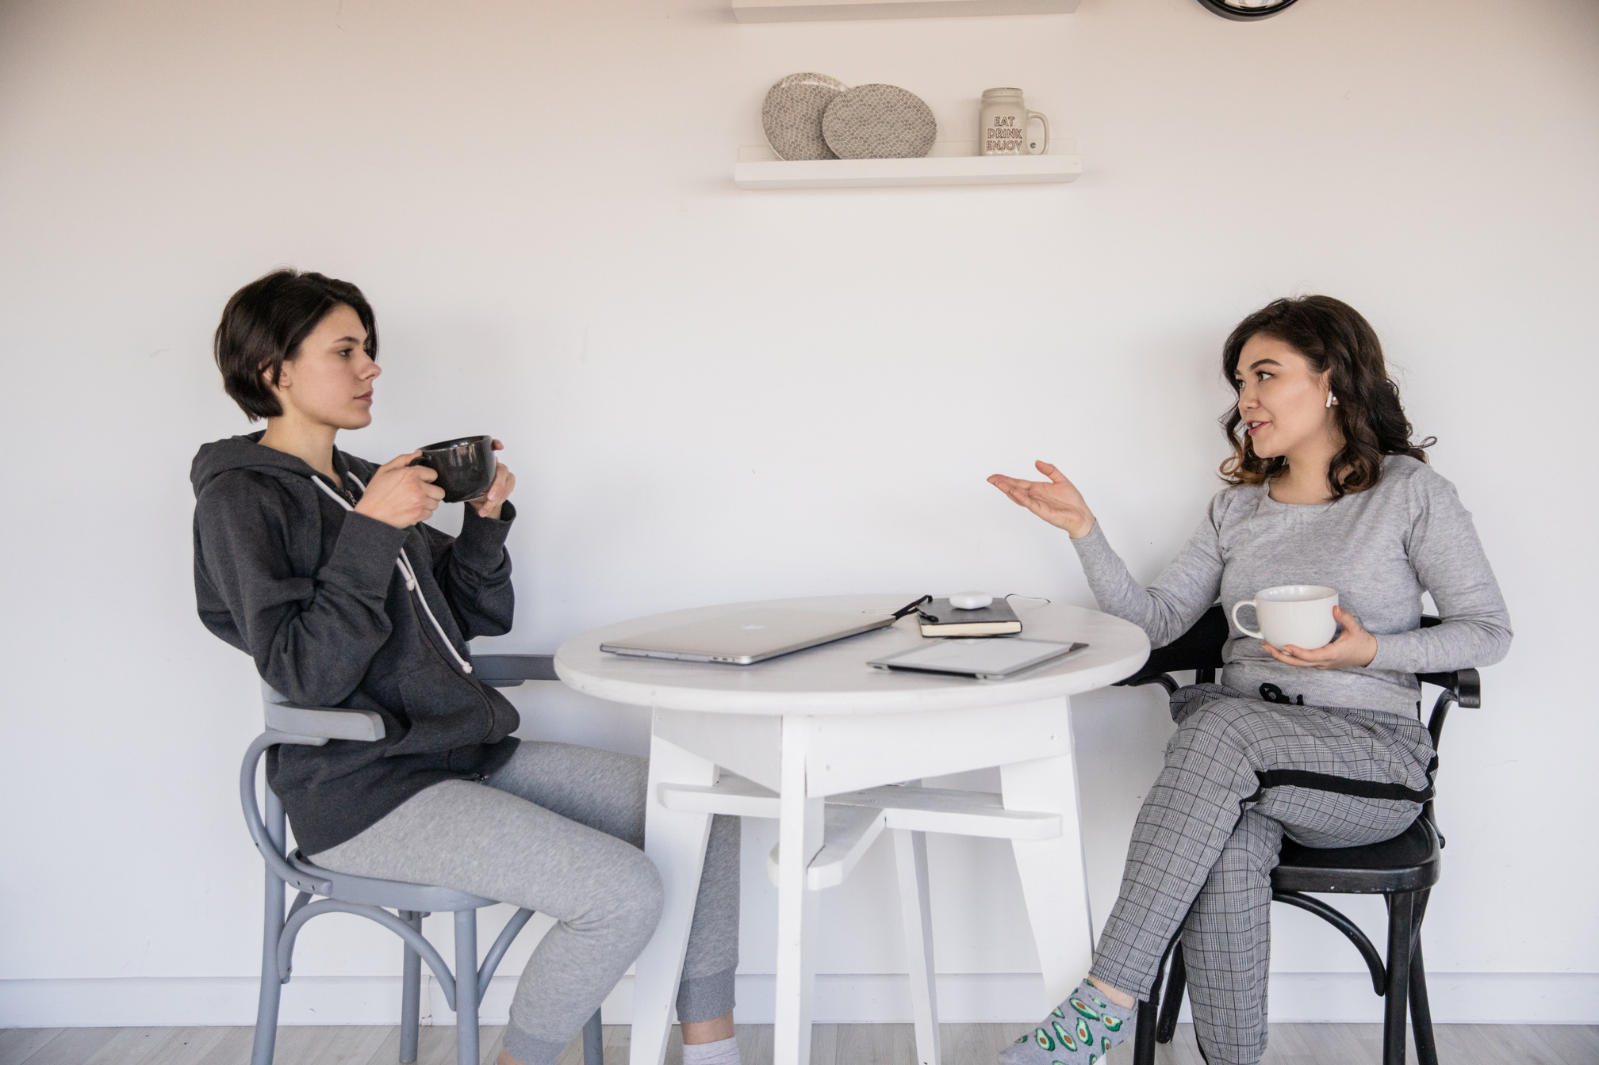
The Untangle Project
Creating Space for Women’s Voices in the Story of Gambling Harm
17 October 2025

Slide 2
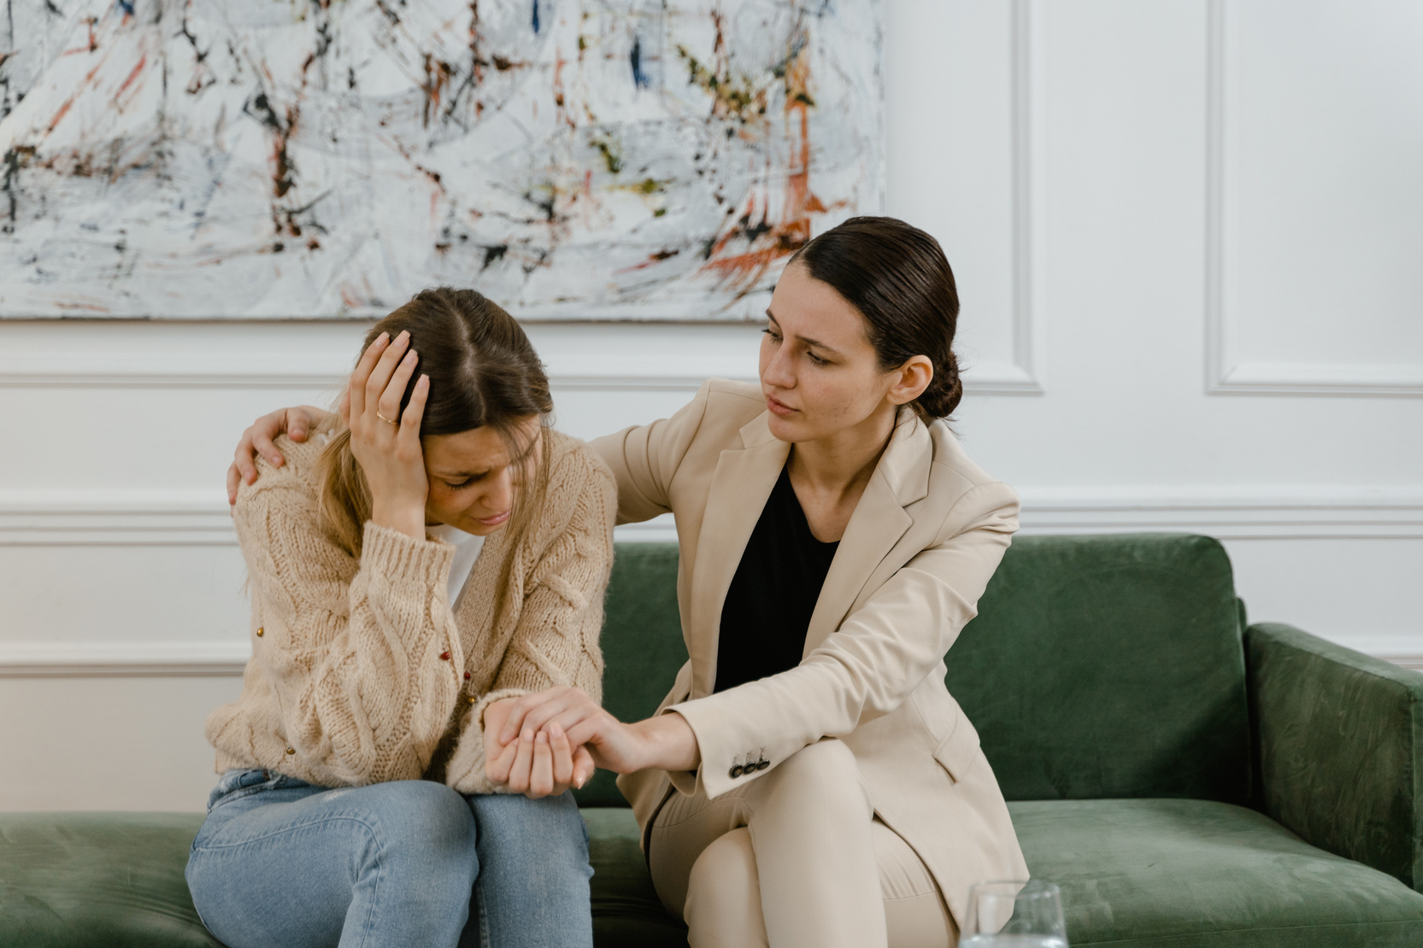
What we’re going to talk about
Who we are
The Untangle Project and our aim
What we’ve done so far
Our current projects (documentary)
What’s next
How you can help

Slide 3
Anna Kennett - Founder
Lisa Kennewell – Advocacy and Wellness Officer
Introductions
Interim Management Committee
Mix of lived experience and other skill sets

Slide 4

Our goals
A safe non-judgmental space for women experiencing the negative impacts of gambling harm or helping someone else through it
Equalising the voice of women in the conversation around gambling harm in state, national and international forums
Allow women to ‘recover quietly’ – in their own way and without judgment

Slide 5
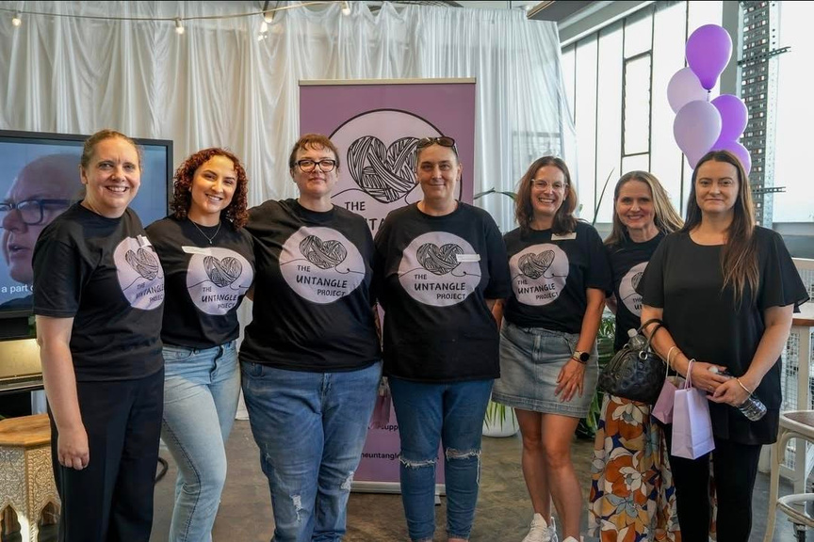
Progress so far
Media coverage
Launch event
Strategic partnerships
National media attention including appearances on The Project (TV) and Mamamia No Filter (Podcast).
Invitation from Nadia Clancy MP to attend at Suicide Prevention Council Community Forum
Regular speaking engagements including at Uniting Communities and Beyond Blue.
Formally incorporated on 7 March 2025.
Launch event held March 2025, hosted by Lauren Novak. Attended by representatives from DHS, Embolden and Relationships Australia.
Embolden
DHS
Relationships Australia
Uniting Communities
The Broke Girl Society
The Alliance for Gambling Reform
Lived experience advocates locally, nationally and internationally

Slide 6
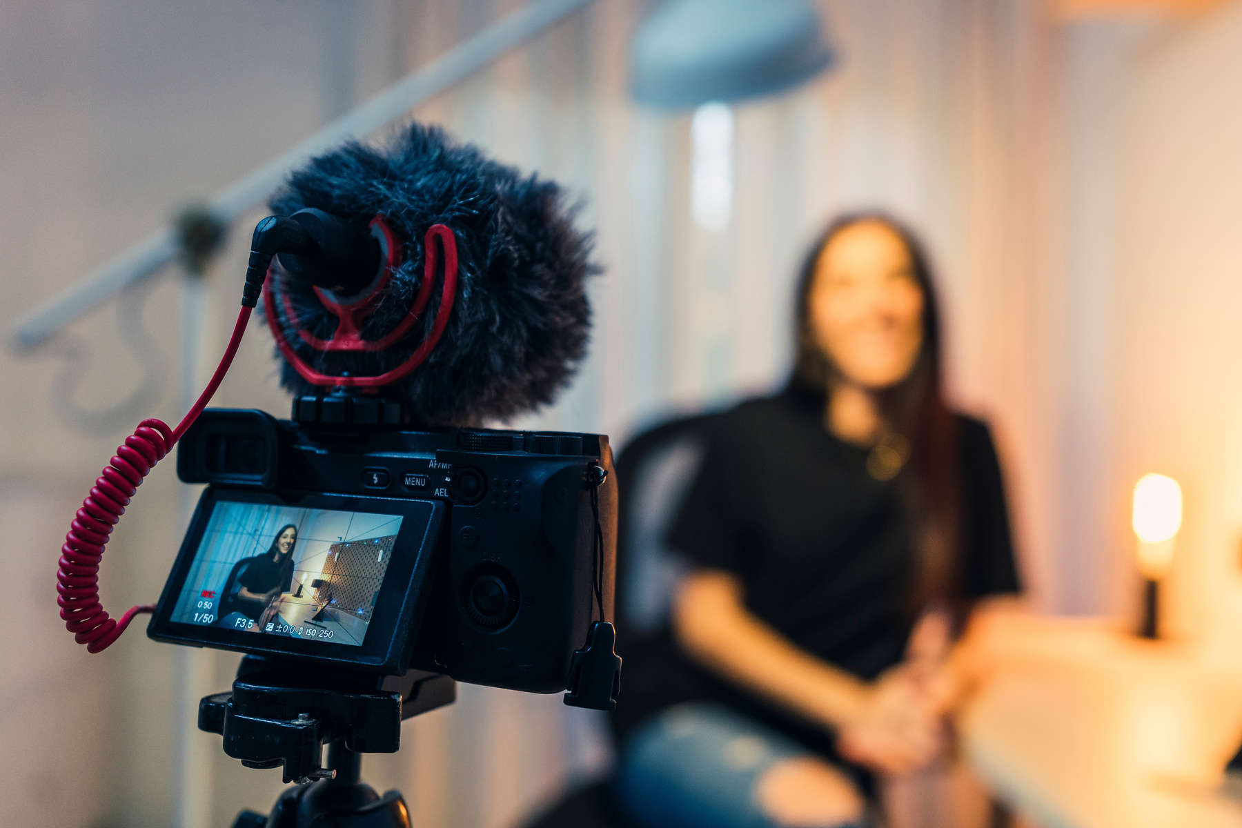
Community Documentary: Untangle – Conversations That Matter
Partnership with TBD Studios (a creative collective of artists, film makers and story tellers based in Adelaide).
Being run, planned and implemented with the lived experience perspective at the forefront of every decision that is made.
We’re telling stories of gambling harm for women in ways that haven’t been done before and from perspectives that haven’t been heard before (currently at interview stage).
Lived experience advocates, industry insiders / whistleblowers / academics and lots of other perspectives signed on to be interviewed.
Current focus

Slide 7
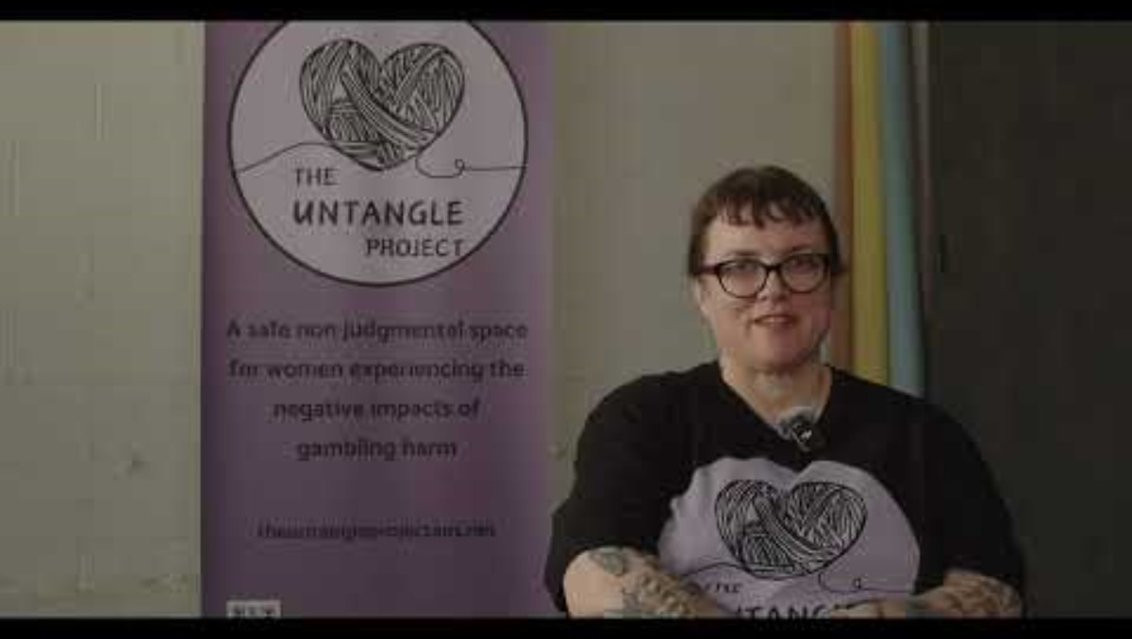

Slide 8

Podcast – Untangling on Air
Resource development – alternative recovery course (pilot model)
Key driver is to ensure we have an end product that highlights the unique positioning of South Australian women as leaders for change
Current projects
Work is being done at every step of the way with the lived experience perspective at the forefront of planning and outcomes

Slide 9


Future plans

Slide 10
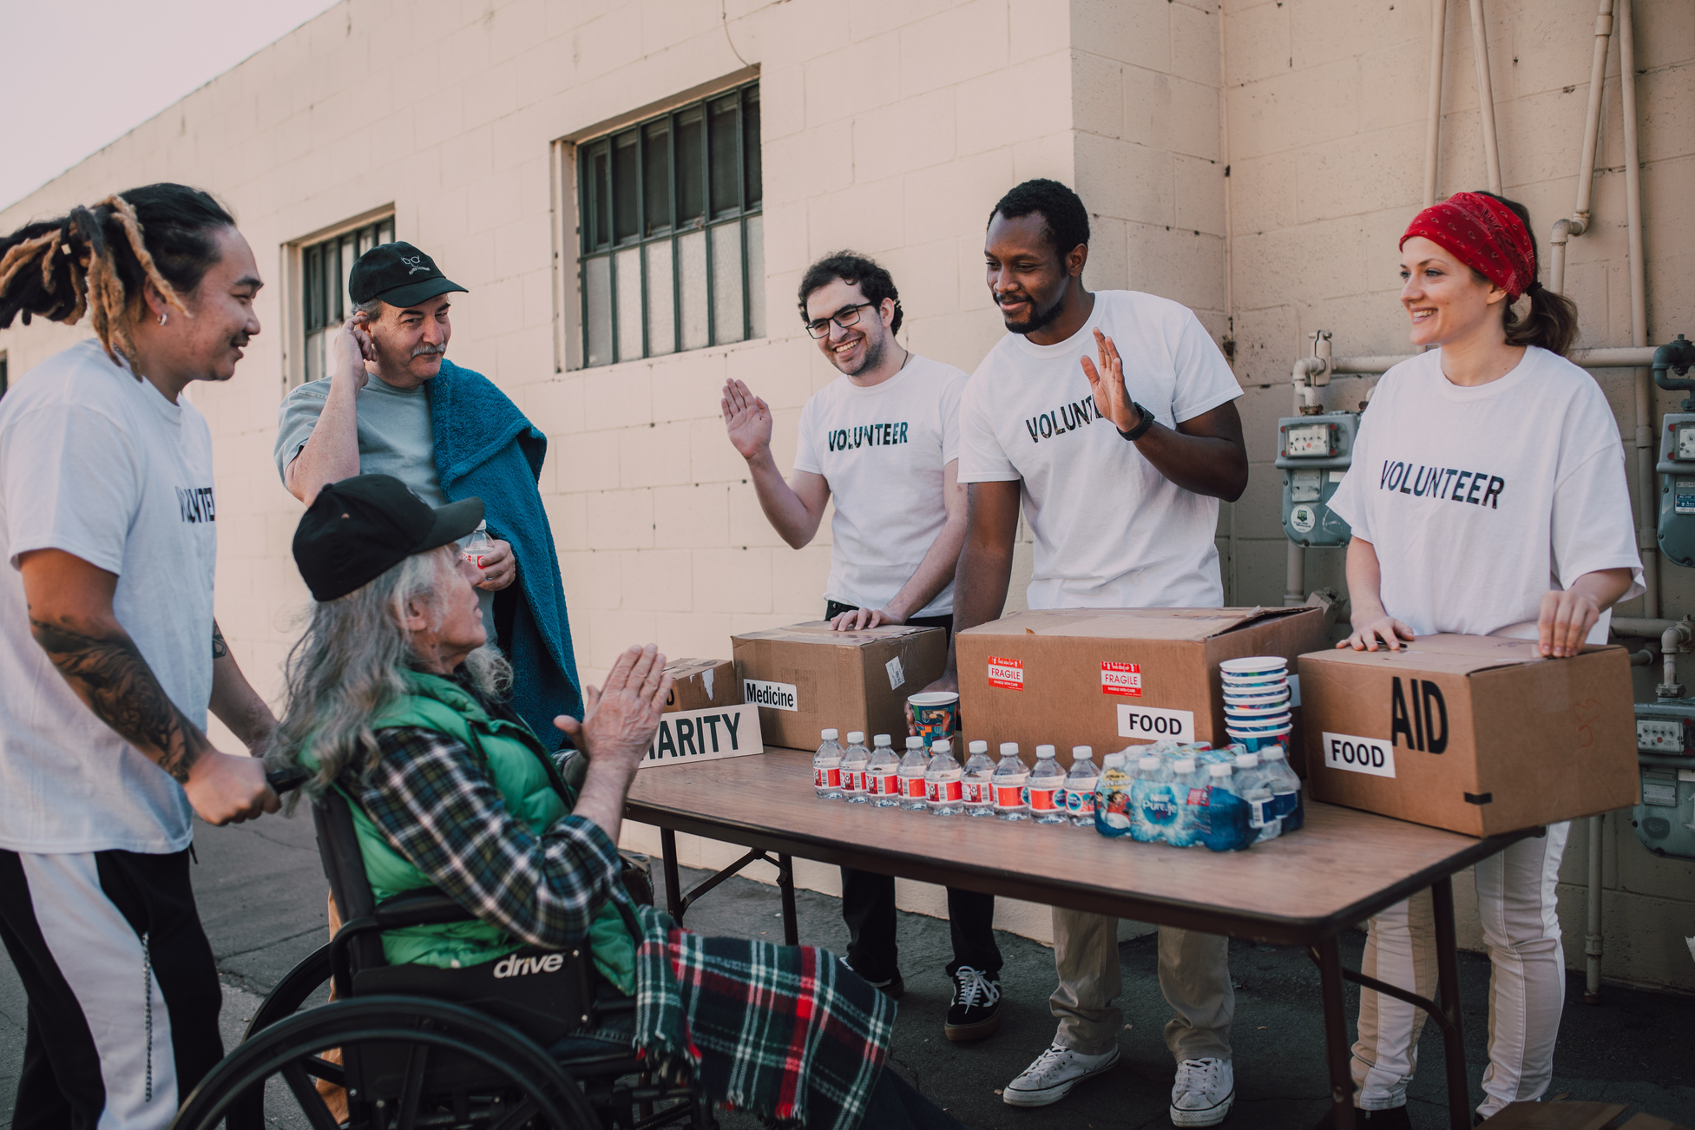
How You Can Help
Participating in the documentary
Interviews, promotion and connection
Having important conversations
Promoting safety and wellness
Want to help us financially?
Visit www.theuntangleprojectaus.net
Volunteer for our events
(documentary launch – aiming for late 2026)

Slide 11




Stay connected
www.theuntangleprojectaus.net
Anna Kennett
Lisa Kennewell
anna@theuntangleprojectaus.net
lisa@theuntangleprojectaus.net
@theuntangleprojectaus

