Slide 1



Slide 2


Gambling, Gaming and Young People
Presented by Alexis Tehel

Slide 3
Talking Points
Learn about our school seminar series called Level Up
Discuss the rise of gambling in online games popular amongst young people
See the results of a survey at a local high school about gambling behaviours

Slide 4


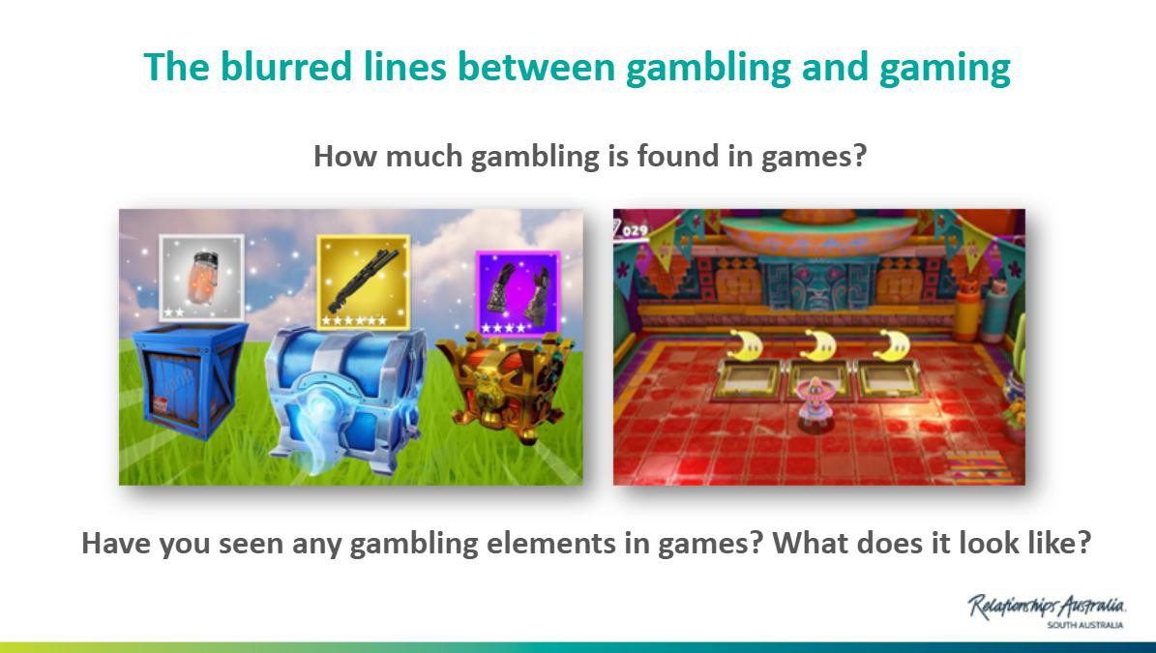
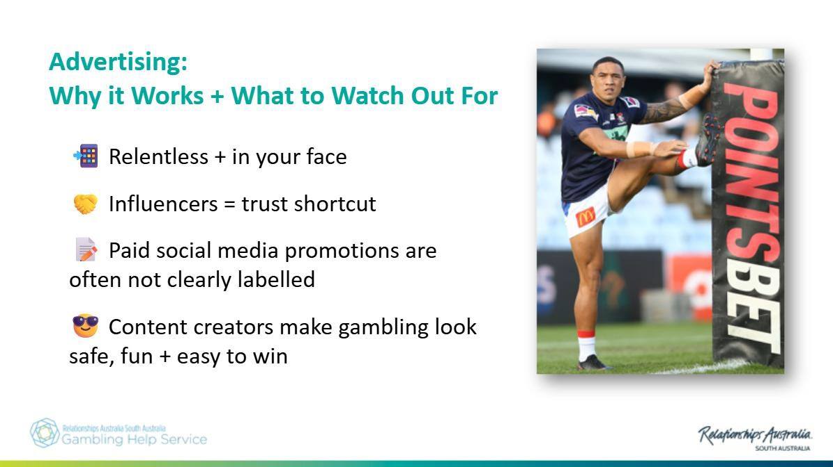
Level Up: Gaming
Level Up: Gambling

Slide 5
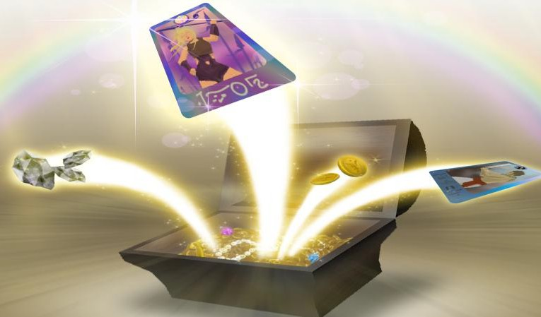
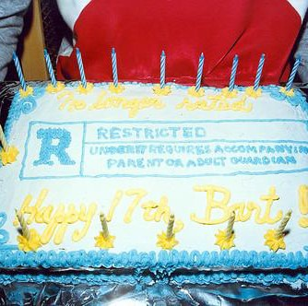
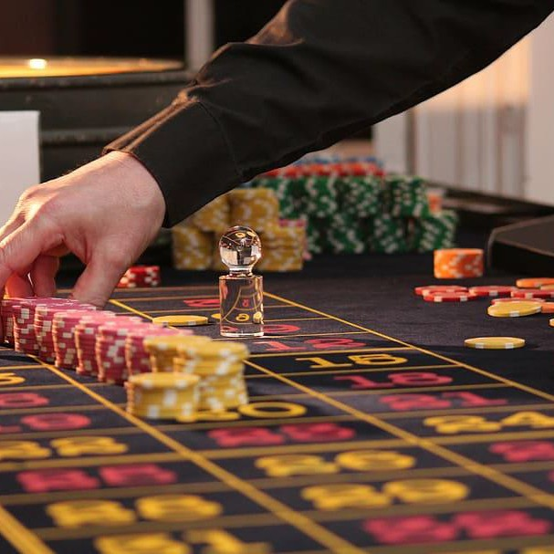
Why are we talking about gaming in a gambling seminar?
Game features like loot boxes and social casino apps mirror gambling’s “pay, spin, random reward” loop.
Australia updated its rules in Sep 2024: games with paid loot boxes must be M (not recommended <15) and games with simulated gambling are R18+.
That shift reflects evidence these mechanics are associated with later gambling uptake.

Slide 6
Youth Gambling Survey 1040 Responses
Understanding Frequency, Impact, of gambling from years 9-12 at a local SA high School

Slide 7
Survey Overview
Overview
Total responses: 1040
Age range : 13-17 years, high school in SA
Designed by a student doing a Thesis on gambling harm and young people.
Purpose
To explore how often young people gamble and capture their experiences.
Focus
Frequency, impact and areas for further exploration and early
intervention

Slide 8
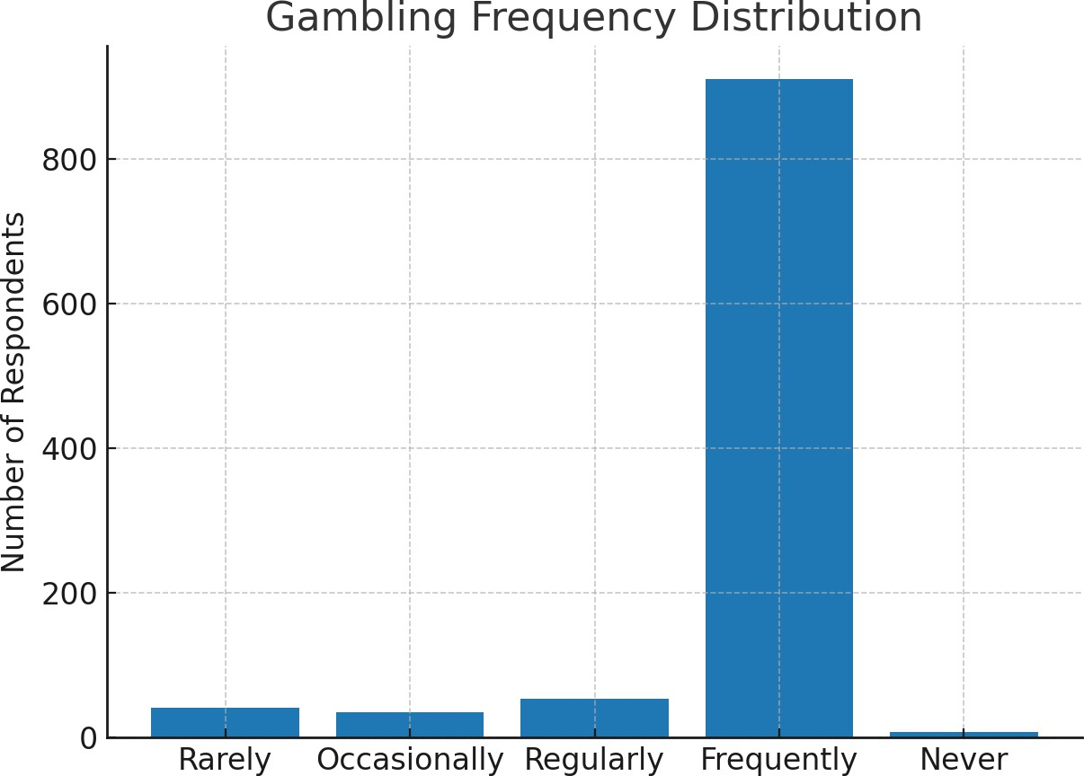
Gambling Frequency Distribution

Slide 9
Key Insight
Gambling is widespread and normalized.
Only 7 out of 1040 respondents said they never gamble.
Indicates exposure, accessibility, and strong peer influence.

Slide 10
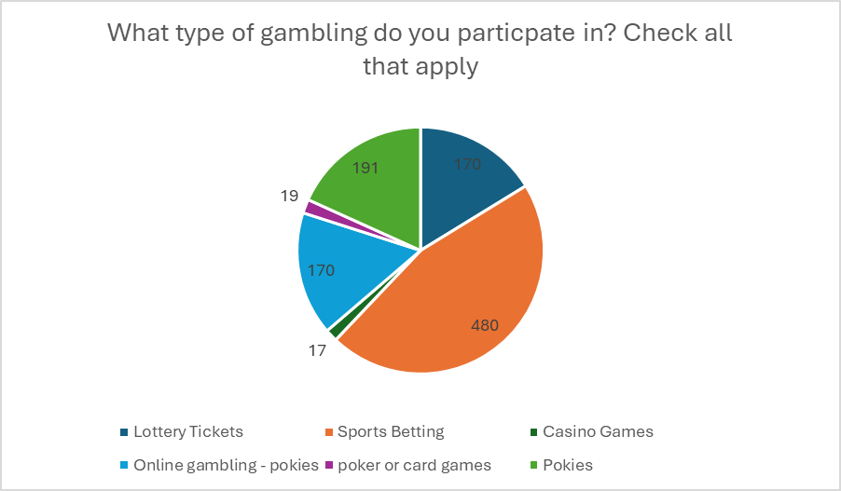
Types of Gambling

Slide 11

Key Insight
Sports betting is by far the most common form of gambling (480 responses), followed by pokies and lottery tickets. Indicates popularity of easily accessible forms.

Slide 12
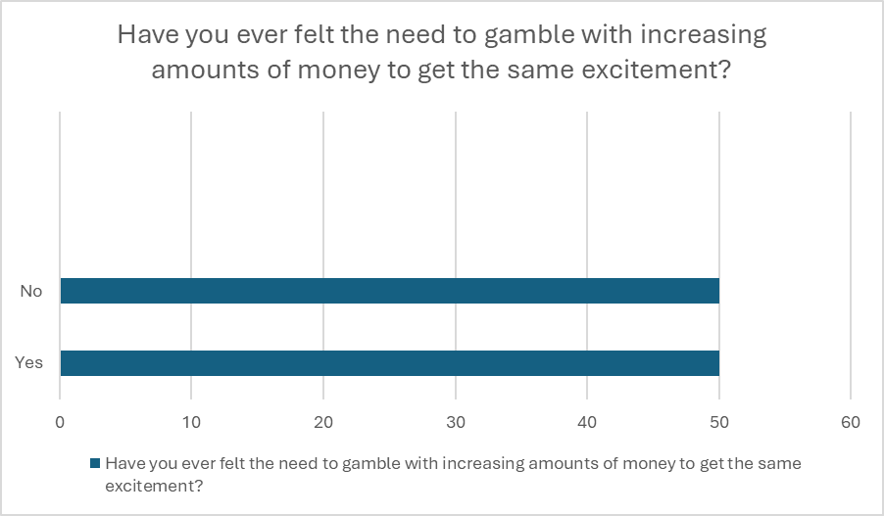
Tolerance – Increasing Amounts

Slide 13

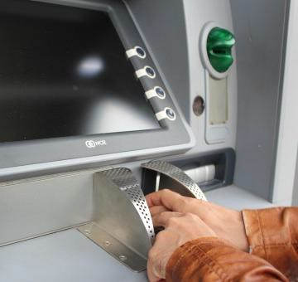
Key Insight
Half of respondents reported needing to gamble with increasing amounts of money to feel the same excitement
— a sign of tolerance and addiction.

Slide 14
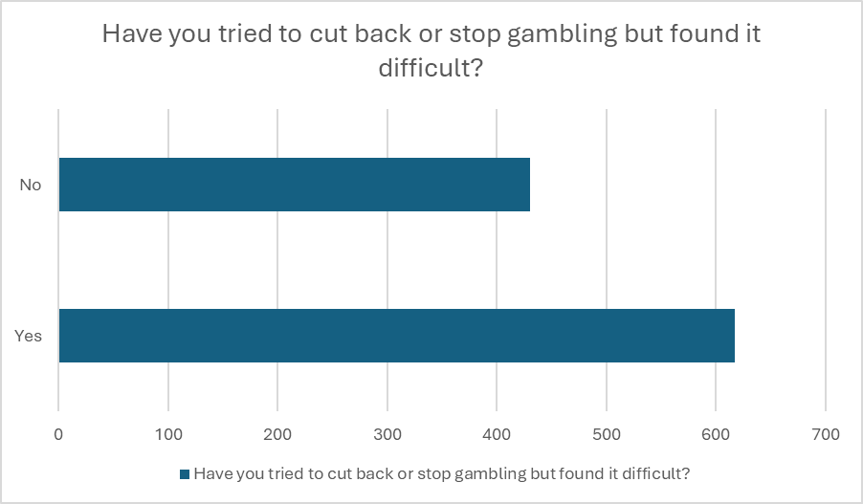
Difficulty Cutting Back

Slide 15
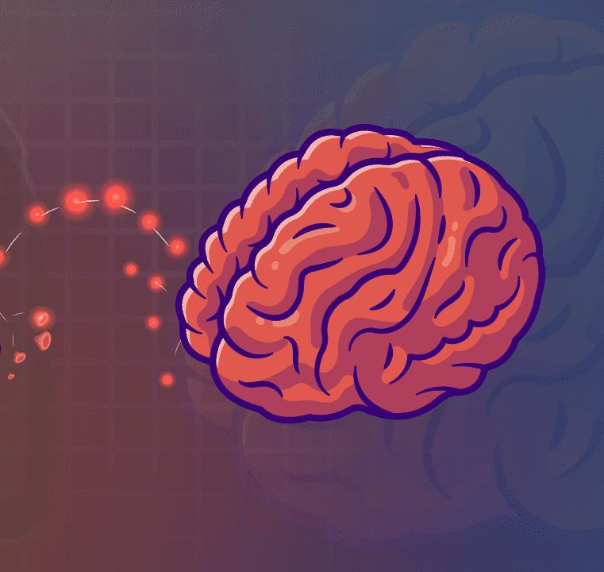
Key Insight
Over 600 respondents reported trying to stop or cut back but finding it difficult — highlighting dependency and loss of control.
This Photo by Unknown Author is licensed under CC BY-SA

Slide 16
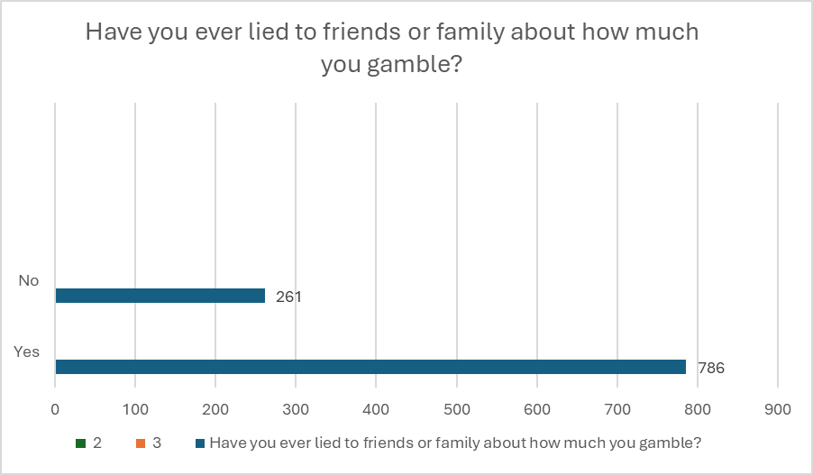
Lying About Gambling

Slide 17

Key Insight
The majority (786) admitted lying to friends or family about gambling, showing secrecy and stigma around the behaviour.

Slide 18
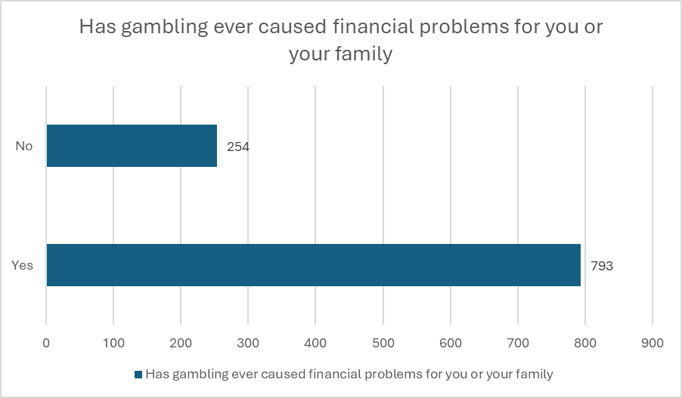
Financial Problems

Slide 19

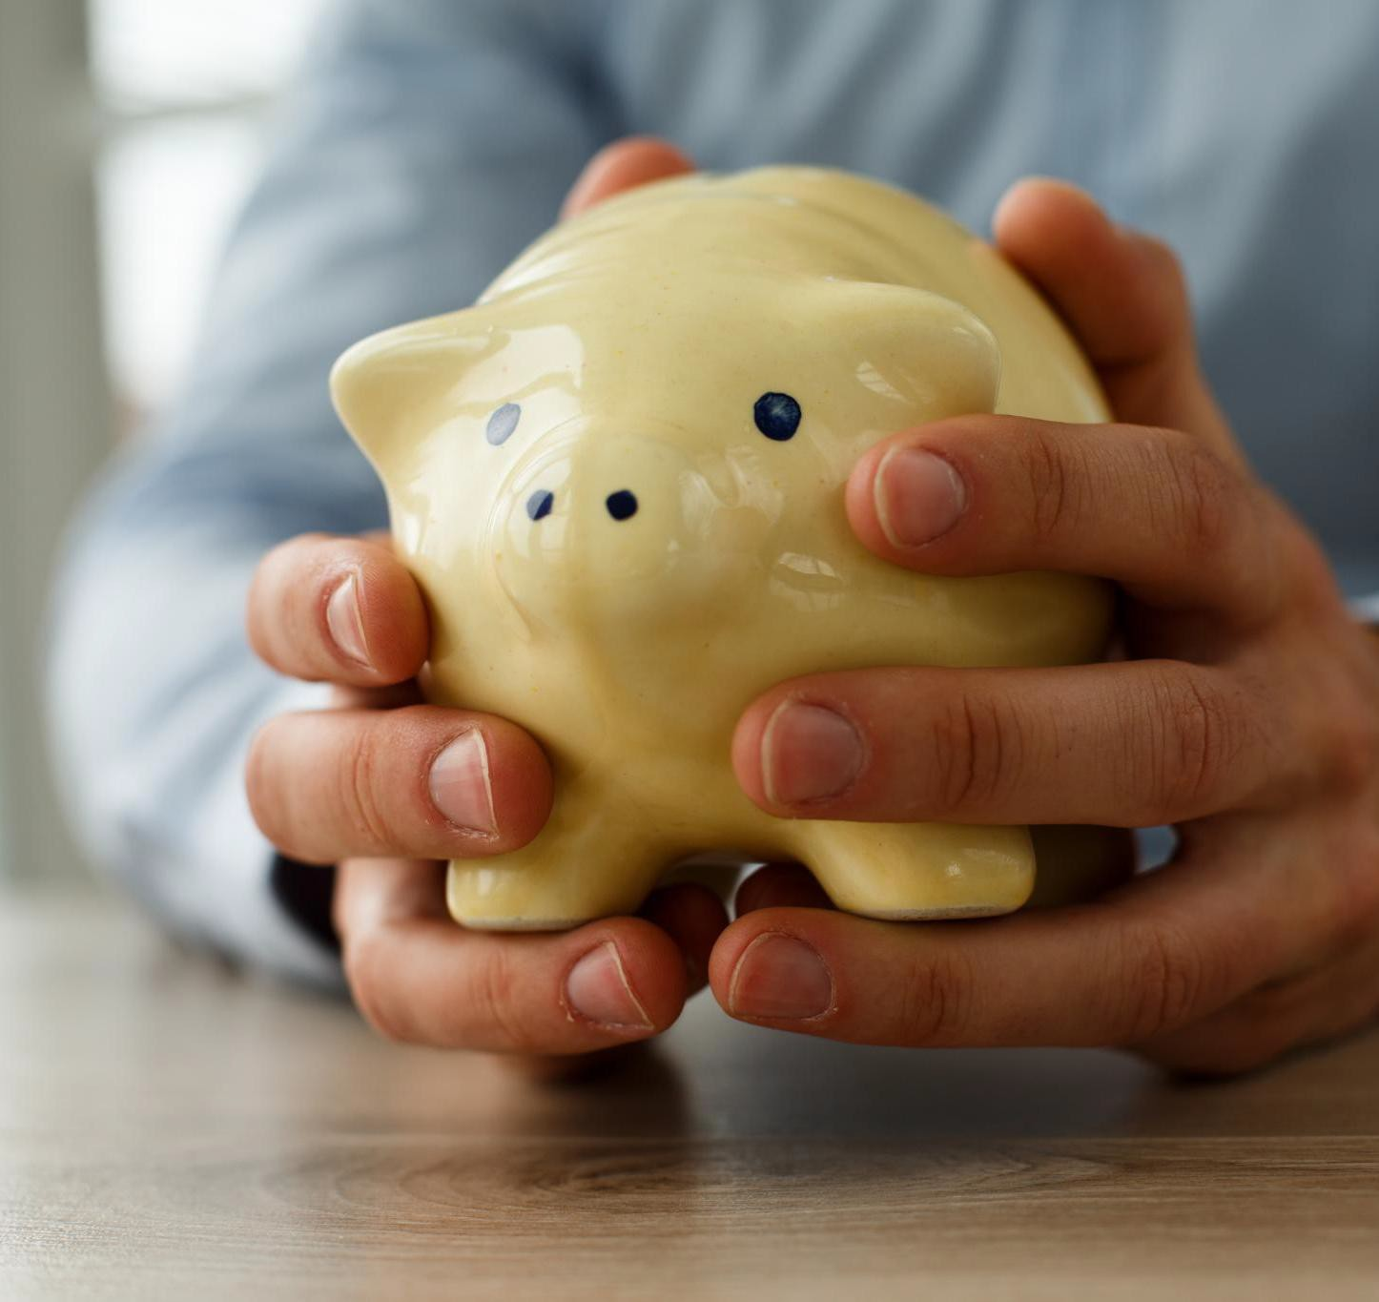
Key Insight
Nearly 800 respondents reported gambling had caused financial problems for themselves or their family — a major harm indicator.

Slide 20
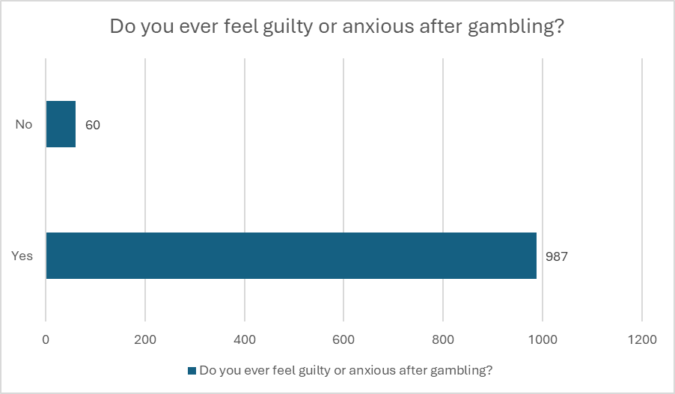
Guilt or Anxiety

Slide 21

Key Insight
Almost all respondents (987) felt guilt or anxiety after gambling — strong emotional and mental health consequences.

Slide 22
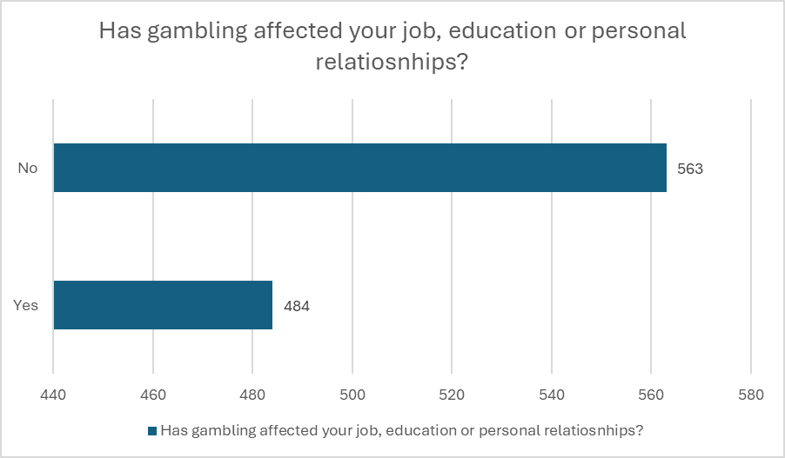
Impact on Life/Relationships

Slide 23

Key Insight
Gambling has affected education, jobs, or relationships for nearly half of respondents, revealing real-life implications

Slide 24
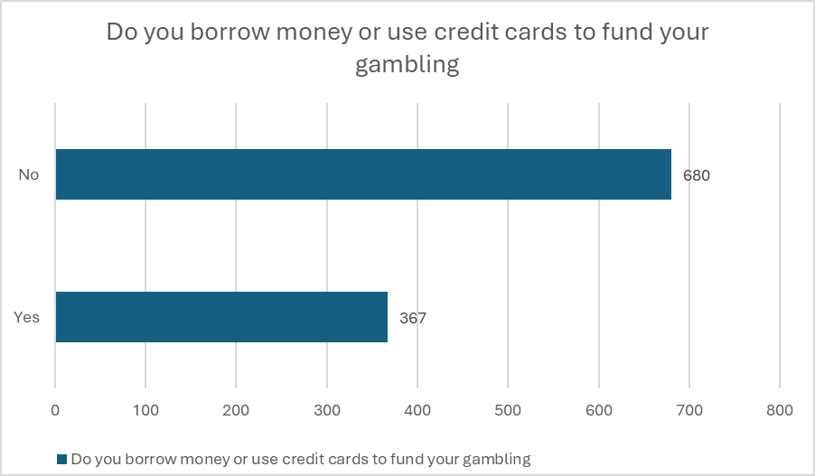
Borrowing Money

Slide 25
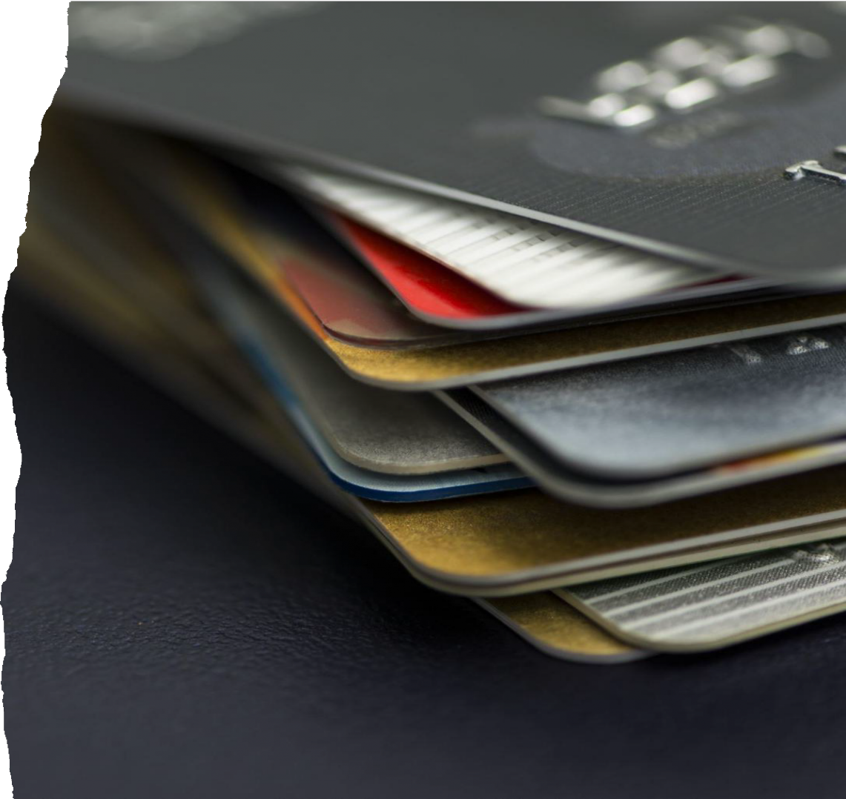
Key Insight
Over 360 respondents admitted borrowing money or using credit cards to gamble, showing financial risk- taking and harm.

Slide 26
Quotes From Survey Participants
“You feel like you’re in control but really, the app is controlling you”
“It’s weird how they make it look cool when people are losing everything”
“My cousin started betting on sports and lost a ton of money”
“I see betting ads all the time on TikTok and Insta”
“It starts with $5 and before you know it you’re chasing losses”

Slide 27
Quotes From Survey Participants
“I don’t gamble but I know someone who does and is heavily addicted”
“If I stop gambling, I’ll explode”
“The excitement of gambling... makes me happy”
“I gamble most when sport is off-season — I chase the high” “I used to think it was fun until I saw my mum go through it”

Slide 28
Quotes From Survey Participants
“All my mates bet on the footy even though we’re underage”
“We get taught about drugs and alcohol in school but never gambling”
“Have won up to $2000 but lost it all within 30 minutes”
“It messes with your head. You think the next win is around the corner”
“It needs to be talked about more — it’s not just an adult problem”

Slide 29
Our Key Takeaways for Level Up Students
Gambling is Here
It can cause Harm You can get Hooked You can get Help
Gambling Helpline: 1800 858 858
Gamblinghelpsa.org.au

Slide 30


