Slide 1
South Australian attitudes, beliefs, and behaviours to sports betting 2021-2025
Matthew Browne, Brenton Williams, Alex M T Russell, Nerilee Hing, Cassandra K. Dittman, Matthew J. Rockloff
July 2025

Slide 2
Key Findings at a Glance
Sports betting participation increased
41.0% (2023) → 44.2% (2025)
Problem gambling rose among gamblers
18.1% (2023) → 22.5% (2025)
Irrational beliefs about betting increased
"My skill helps me win" beliefs up consistently across all waves
Community normalisation decreased
Despite increased participation, betting seen as less normal/acceptable
Campaign awareness remained stable
~31-34% recall "Here for the Game" or "Spoil Sport“
The paradox: More people betting, but less social acceptance

Slide 3
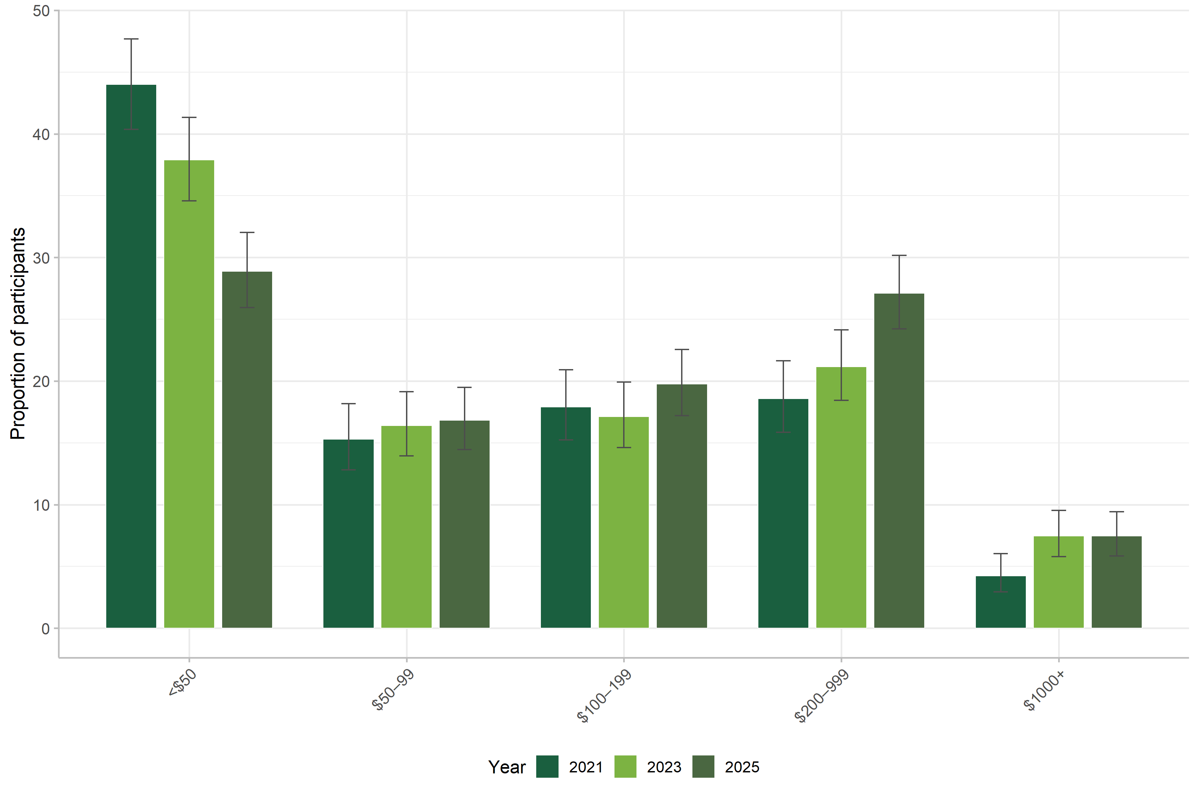
Rising Participation and Expenditure
Spending shifted toward higher categories
Low spending (<$50/month): 44.0% (2021) → 29.0% (2025)
Moderate spending ($200-999/month): 18.6% (2021) → 27.1% (2025)
High spending (>$1000/month): 4.2% (2021) → 7.5% (2025)
In-play (live) betting increased
25.1% (2021) → 31.8% (2023 & 2025)
Sports betting frequency increased significantly
More frequent bettors across all categories

Slide 4
The Normalisation Paradox: Community vs Family
Community normalisation DECREASED:
Overall community normalisation score: 56.53 (2021) → 53.93 (2025) (p < .001)
Sports betting seen as less normal and less part of SA
BUT Family normalisation INCREASED:
Family-related normalisation showed consistent increases across waves (p < .001)
Families more likely to engage in betting-related activities together
All family normalisation items moved toward greater acceptance
Key insight:
Public health messaging reaching community-level attitudes
Family context proving more resistant to change
Need targeted strategies for family environments

Slide 5
Changing Attitudes Toward Children and Risk
Privacy and protection somewhat increasing:
More agreement: "Keep betting conversations private from children" (increased across waves, p < .05)
Less agreement: "It's OK if children see you betting" (decreased, p < .05)
Belief that talking to children about gambling risks is important – slight increase (p < .05)
ALL Irrational beliefs about betting rising markedly:
Overall irrational beliefs score increased consistently across all waves (p < .001)“
“When I win, it's due to my skill and knowledge" – increased
"I can estimate true odds better than advertised odds" – increased
Key concern:
As more people bet, they increasingly attribute success to skill rather than chance
These beliefs strongly associated with problem gambling

Slide 6
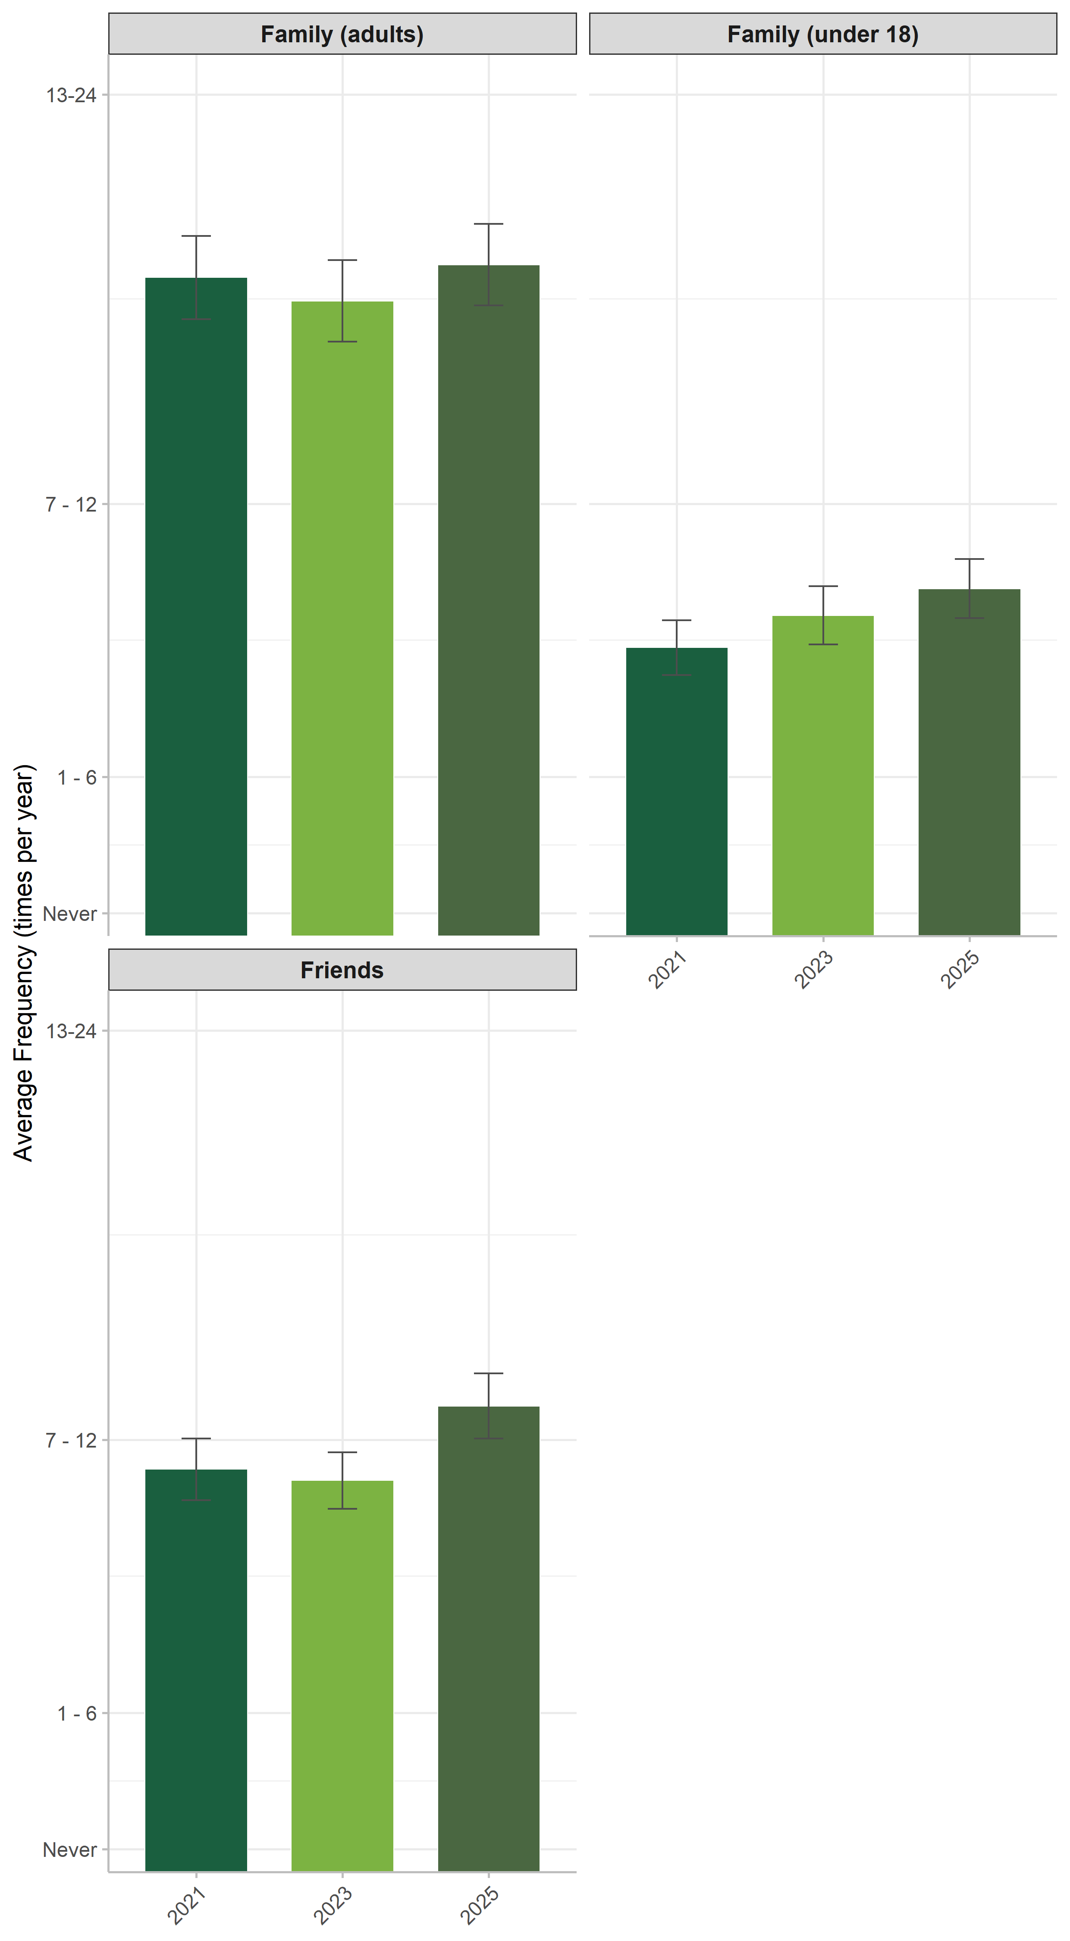
More Sports Watching in Social Settings
Live venue attendance increased significantly (p < .001)
4.77 times/year (2021) → 6.23 times/year (2025)
Watching with friends increased (p < .001)
8.85 times/year (2021) → 10.24 times/year (2025)
Watching with family (incl. children) increased (p < .001)
6.34 times/year (2021) → 7.6 times/year (2025)
Implication: More exposure to betting at venues and in social contexts

Slide 7
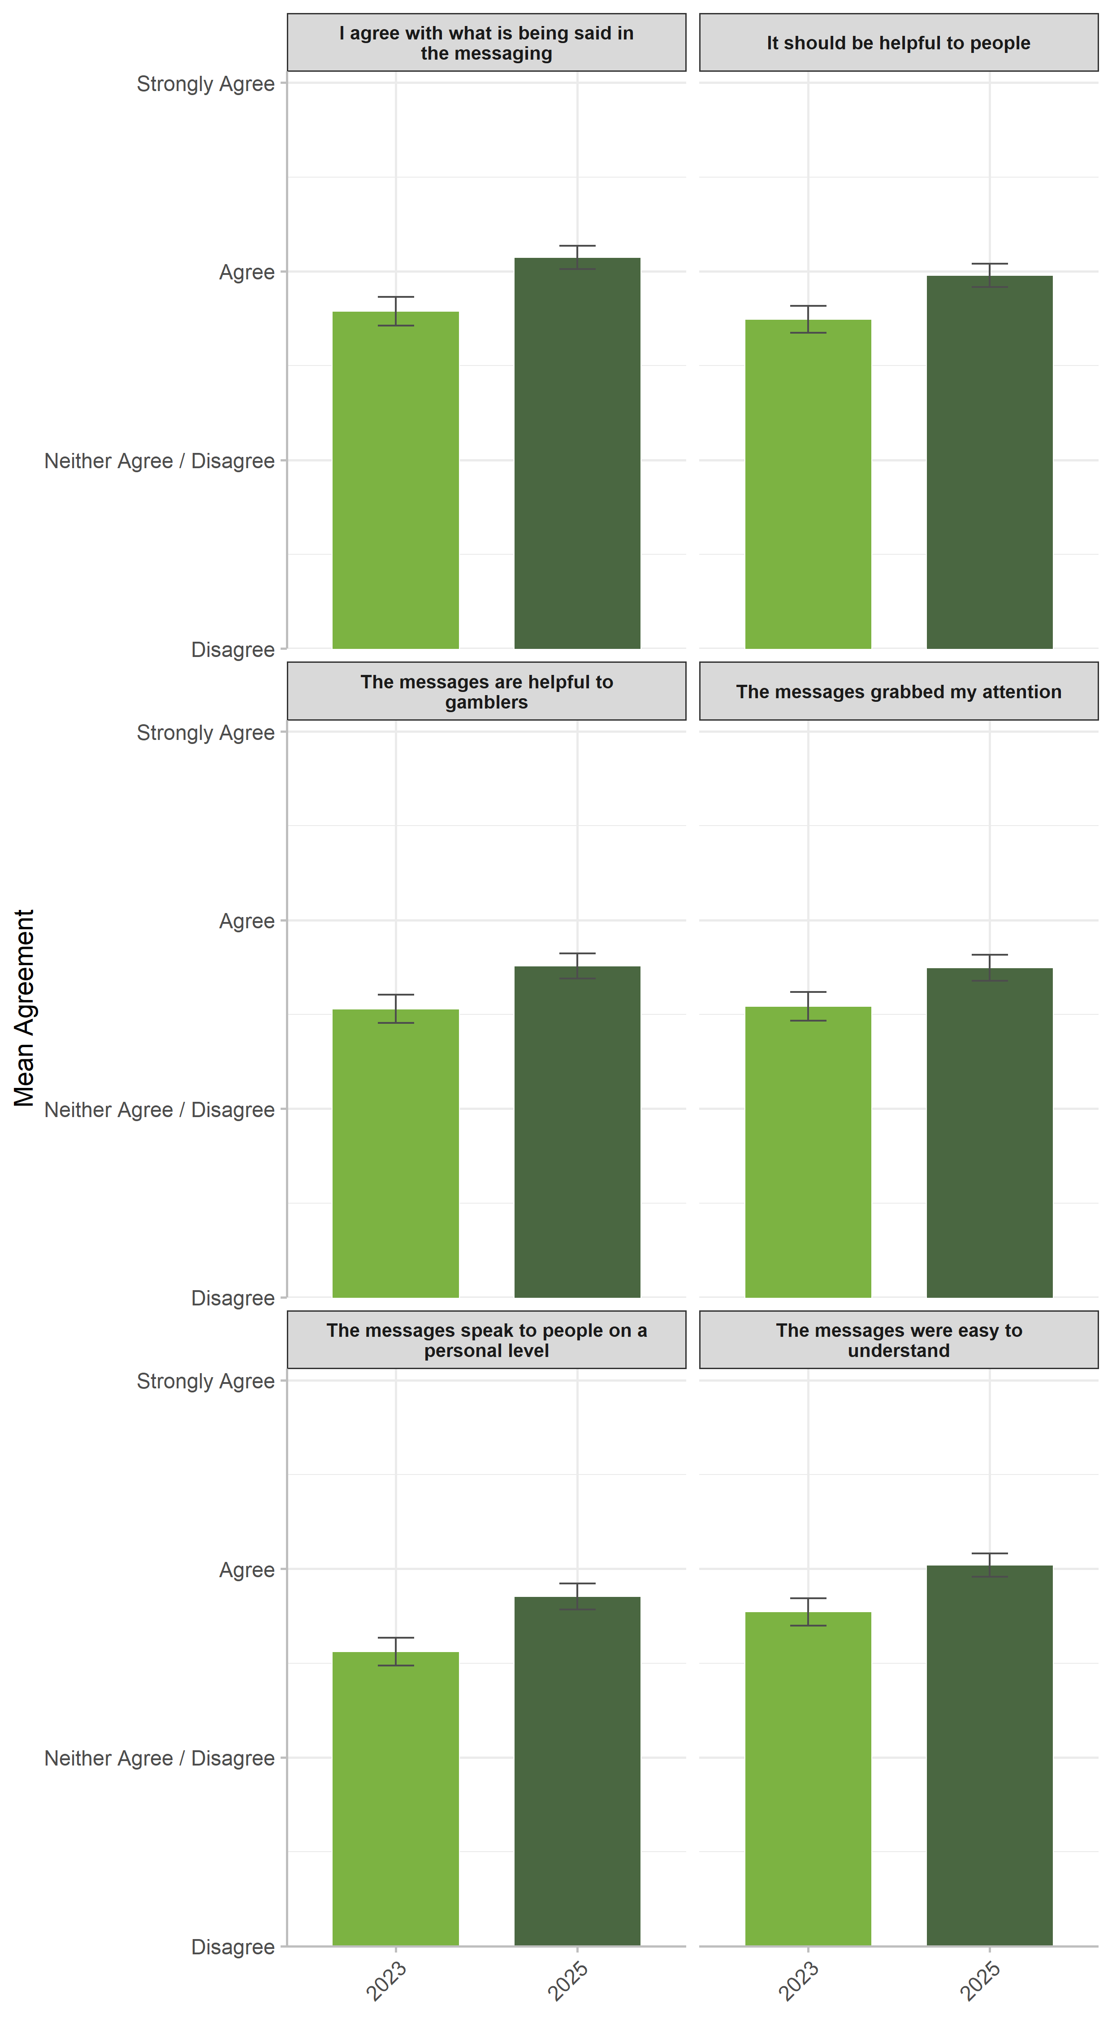
Campaign Awareness and Perceptions
Campaign reach remained stable
31.0% aware in 2023 → 34.3% in 2025
Successfully targeting younger males (recall almost twice as high)
Message perceptions improved significantly (2023 → 2025)
Messages seen as clearer, more helpful, more relevant
Nearly all perception items increased (all p < .05)
"Messages go too far" - no change (remains low agreement)
Key slogans recalled:
"Here for the Game not the Gambling" remains strongest
New "Don't let betting Spoil Sport" at 40% recall (first year)
Sports club associations:
Recall of Crows and AUFC increased
Thunderbirds added in 2025 (20.2% recall)

Slide 8
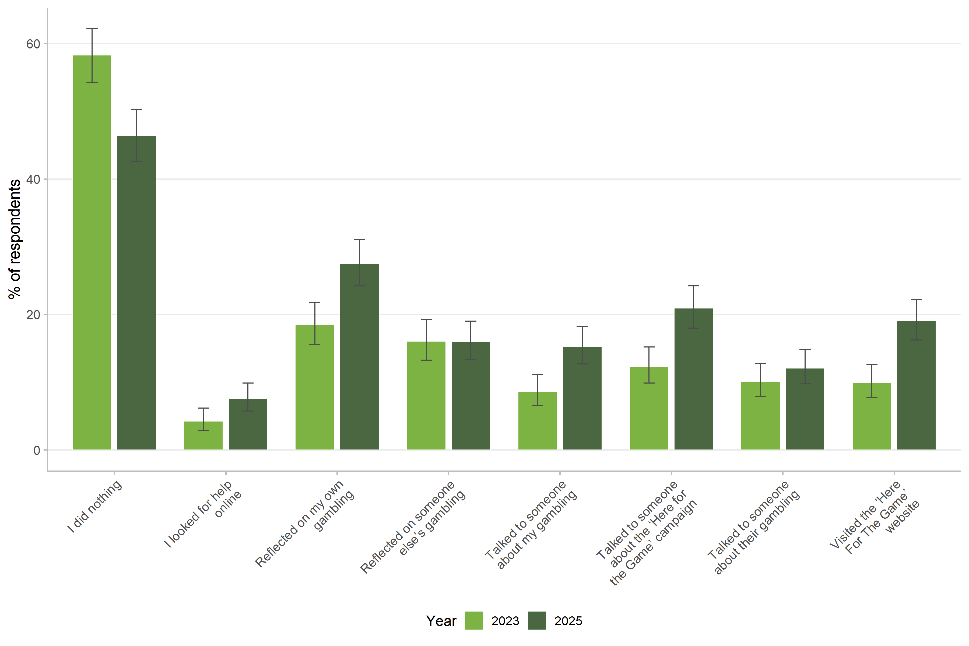
Campaign Driving Action
Major finding: Actions taken after exposure INCREASED significantly (2023 → 2025)
Visited campaign website – increased
Reflected on own gambling – increased
Talked to someone about the campaign – increased
What's NOT changing:
Reflecting on someone else's gambling – stable
Talking to someone about their gambling – stable
Interpretation: Campaign prompting self-reflection and discussion, but not yet peer intervention

Slide 9
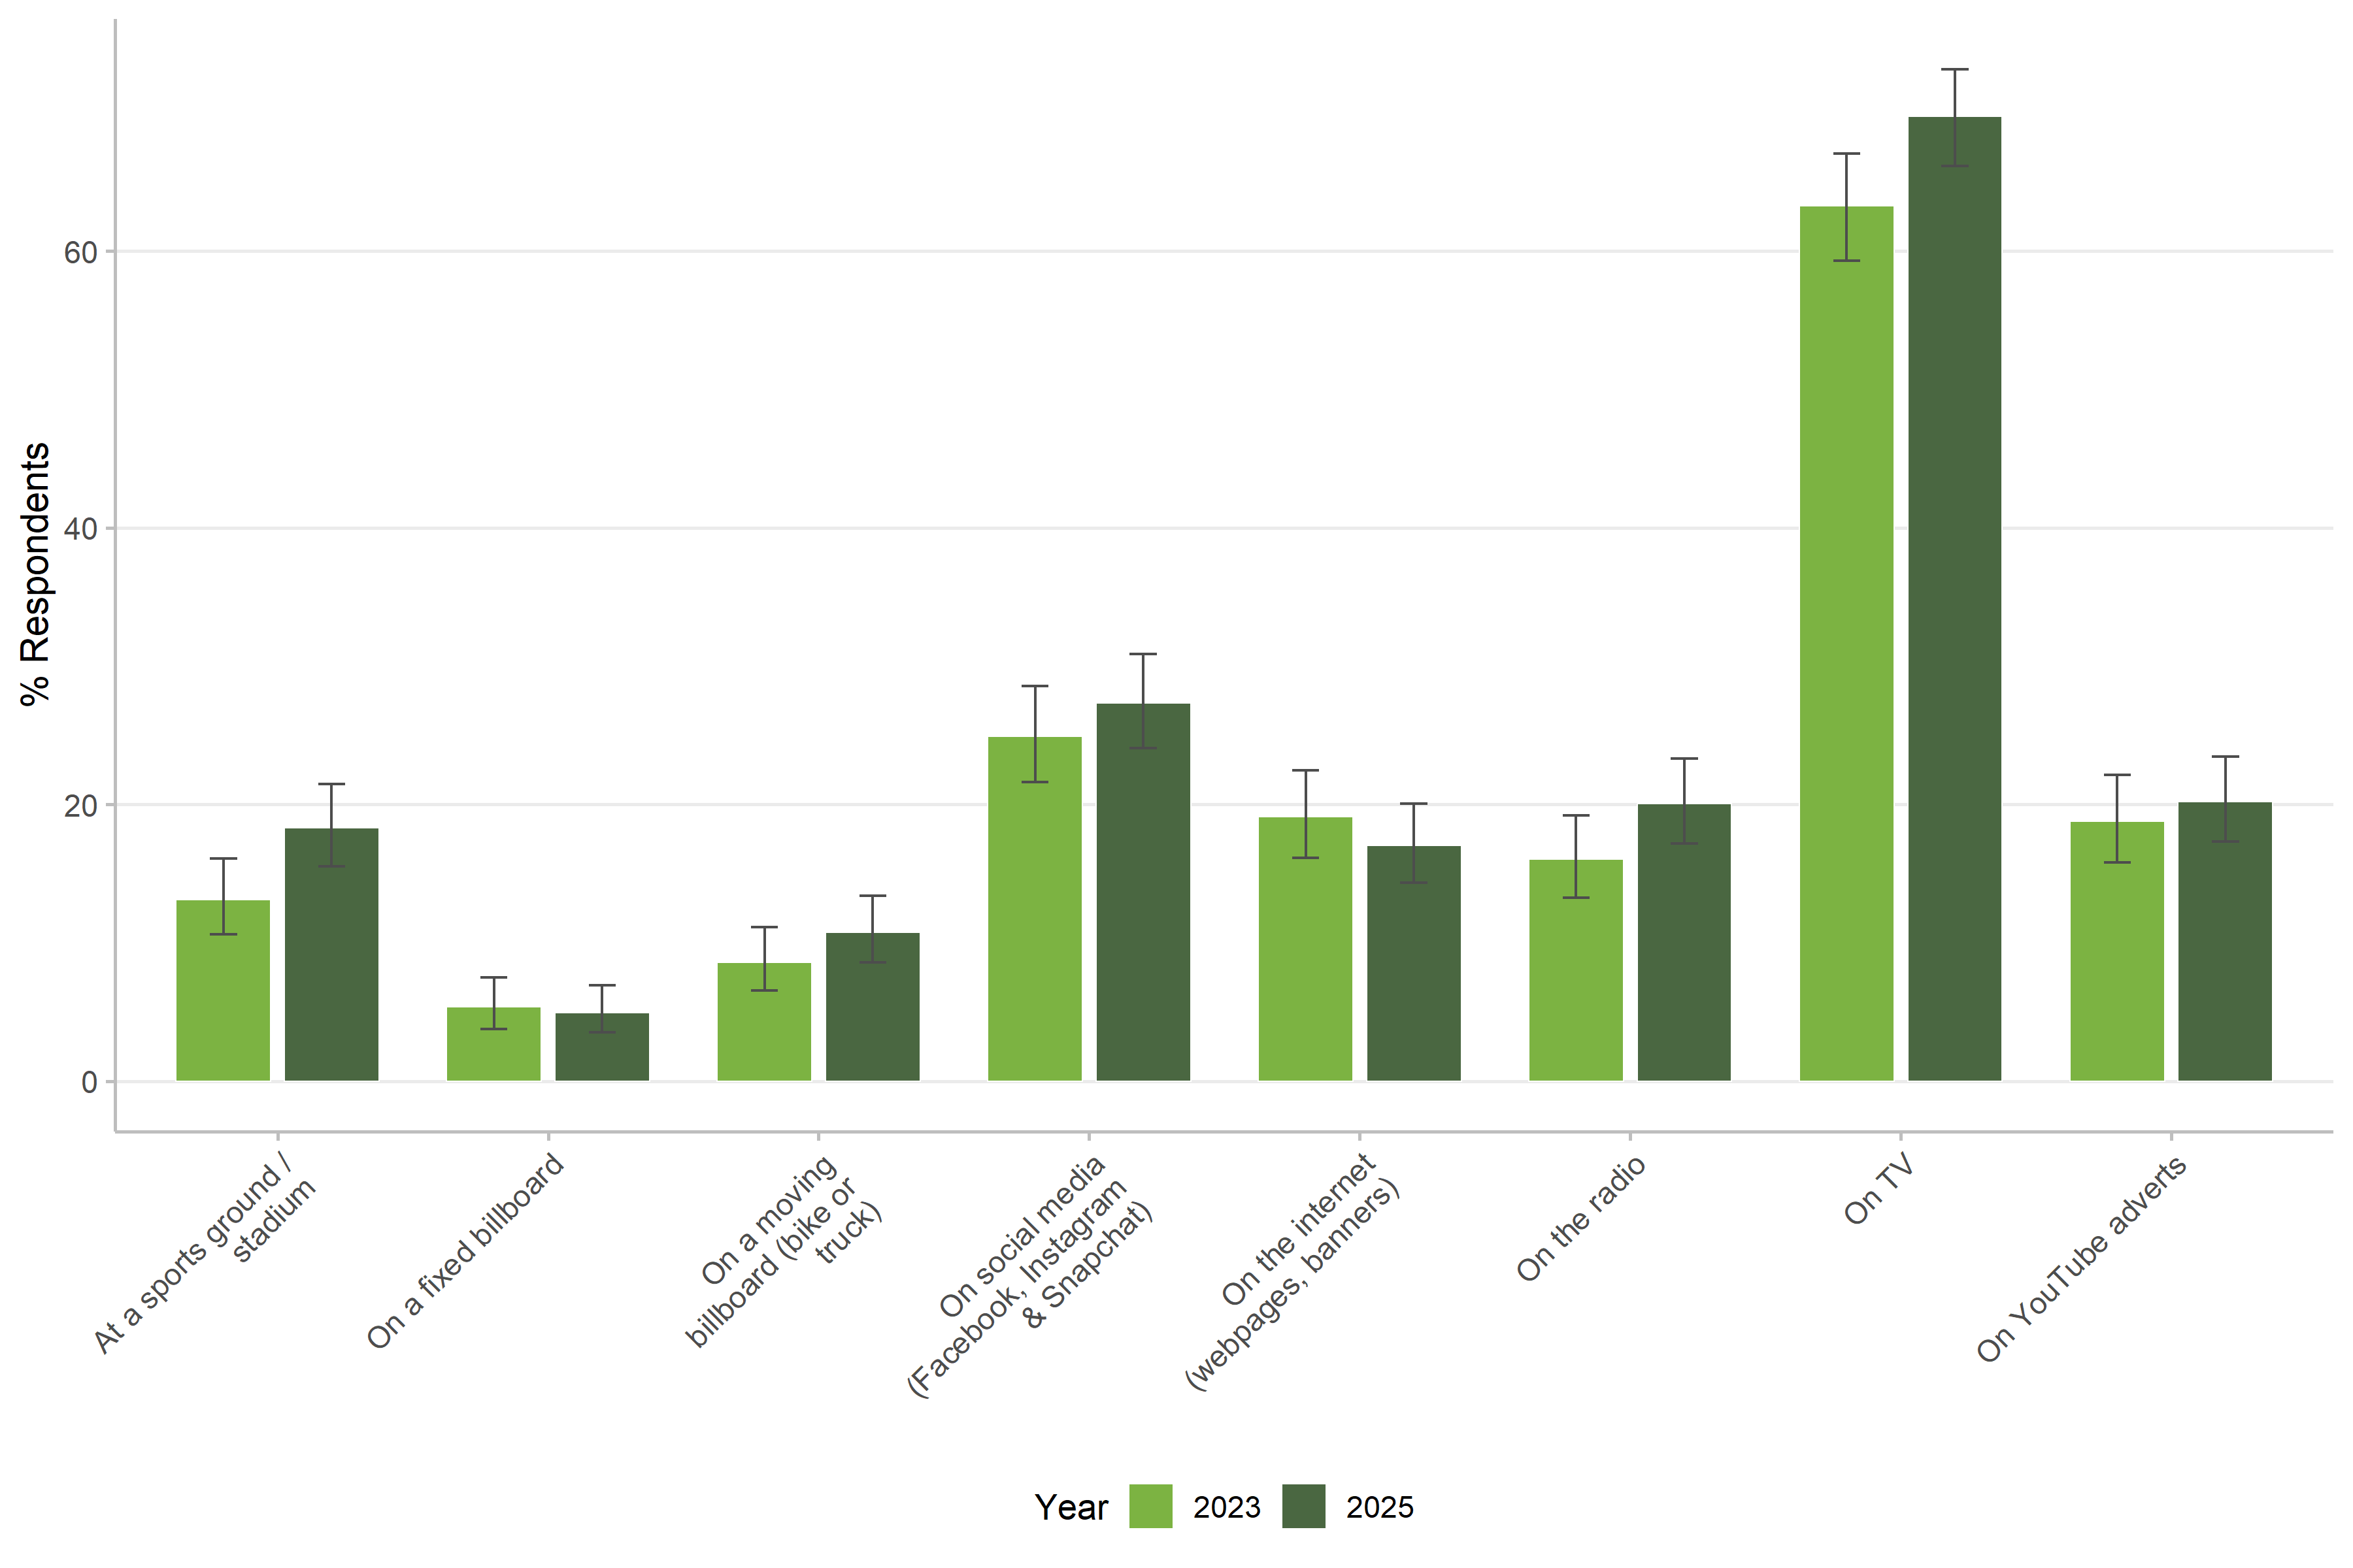
Where People See the Campaigns
TV exposure increased significantly (2023 → 2025)
Remains primary channel for campaign reach
Live sports grounds increased significantly
Aligns with increased live venue attendance overall
New campaign recall:
"Don't let betting Spoil Sport" at 40% recall (first year measured)
"Here for the Game not the Gambling" remains strongest at previous levels
Strategic fit: Campaign appearing where sports fans are watching

Slide 10
Campaign Recall: Competitive Performance
SA anti-gambling campaigns holding their own:
"Here for the Game" recall: 15.9% (when measured against other campaigns)
"Spoil Sport" recall: 40% (among those aware of any campaign)
Combined SA campaign awareness: 34.3% (2025)
Gambling promotion campaigns recalled at similar levels:
Real gambling ads: 5.8% - 20.0%
SA anti-gambling campaigns performing comparably
Context: Some baseline "noise“
Fake/distractor campaigns recalled at 7.2% - 17.9%
Key finding: Public health messaging cutting through despite commercial advertising budgets

Slide 11
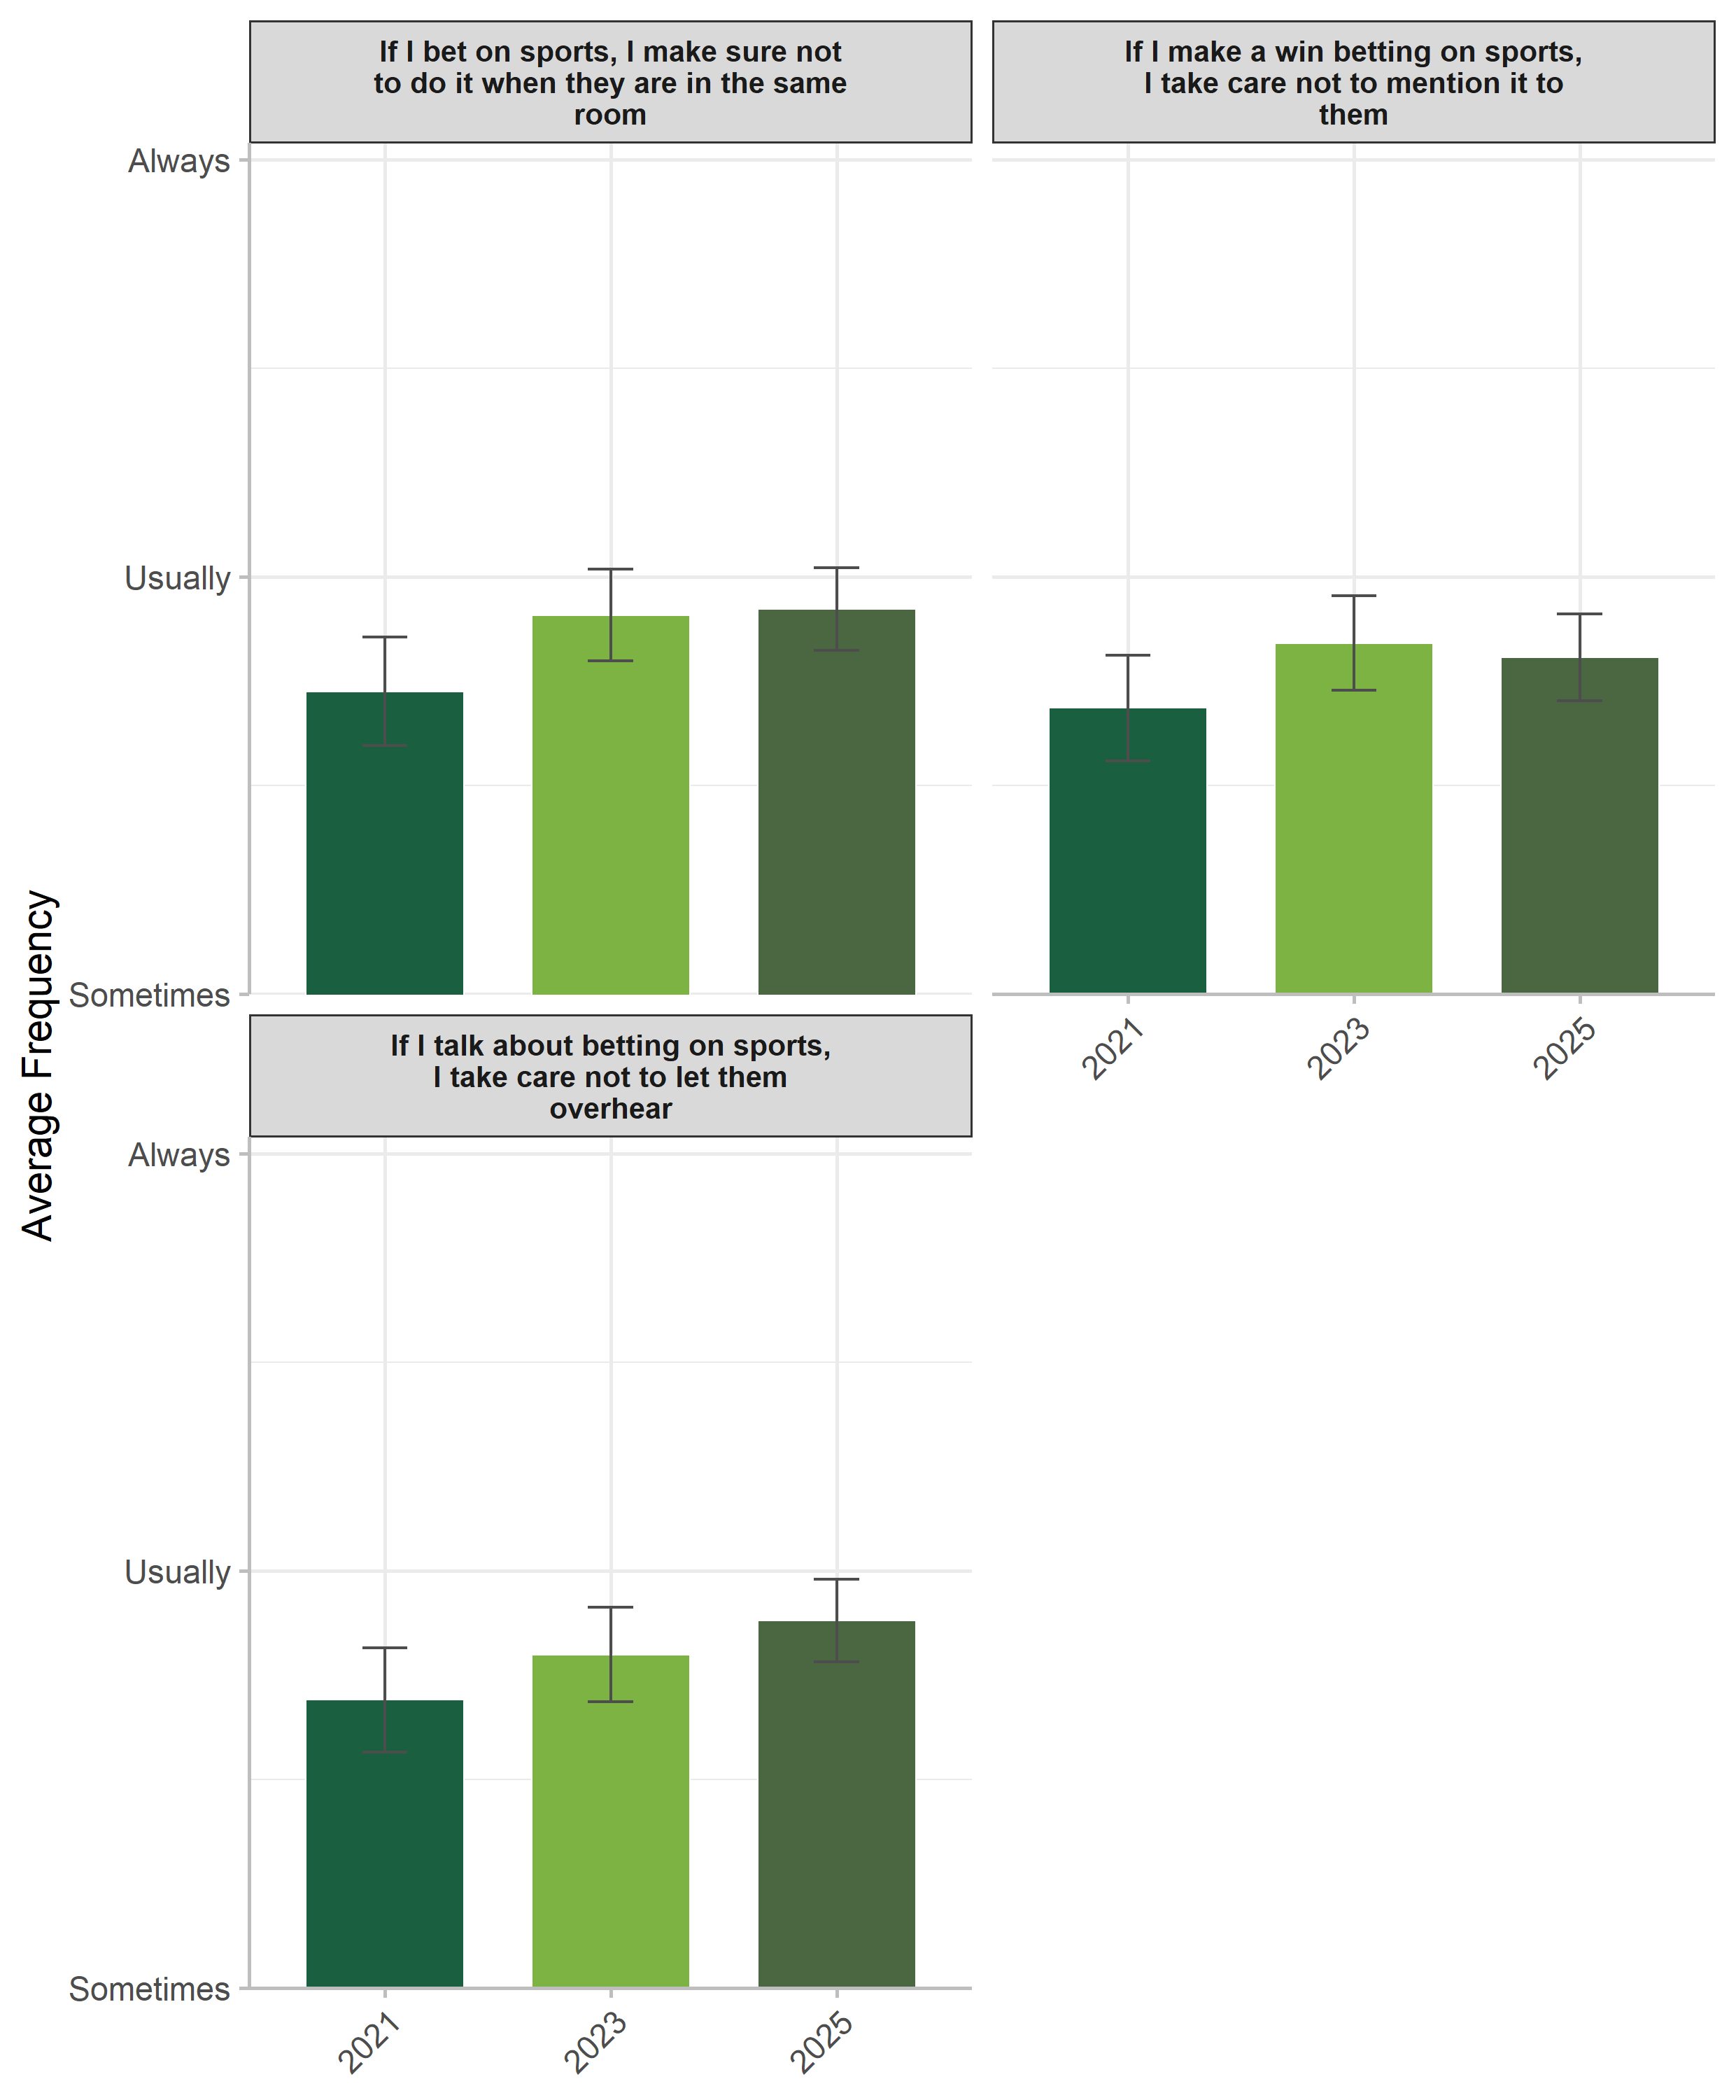
More Conversations About Gambling Risks
Frequency of risk conversations increased (p < .001)
Talking to adults about sports betting risks – up
Talking to children about risks – up
Exposure to safe betting messaging – up
Caregivers taking more protective actions
"Take care not to let them overhear betting talk" - increased (p < .05)
Interpretation: Campaign messaging translating into protective behaviours

Slide 12
Time Effects Remain After Controlling for Covariates
Normalisation decreased significantly (β = -1.151, p < .05)
Effect holds even controlling for demographics and gambling behaviour
Negative attitudes toward sports betting increased (β = .294, p < .05)
Negative opinions about advertising increased (β = .266, p < .05)
Irrational cognitions increased (β = .432, p < .05)
Key point: These shifts aren't just due to sample composition changes
Real attitude changes occurring over time in the community

Slide 13
What Does It All Mean?
Mixed picture: Participation ↑ but community acceptance ↓
More people betting and spending more
But sports betting seen as less normal/acceptable
Campaigns are driving self-reflection and discussion, but not yet peer intervention
Community-level attitudes improving
Self-reflection increasing, but not peer intervention yet
Family context more resistant than community
Family normalisation increasing despite community trends
Concerning trends in harm:
Problem gambling rising (18.1% → 22.5%)
Irrational beliefs increasing
Higher expenditure levels

Slide 14
Implications for Policy and Practice
Community-level messaging is working
Measurable impact from "Here for the Game" / "Spoil Sport" campaigns
Need targeted strategies for family contexts
Family normalisation moving opposite direction to community
Develop messaging specifically for family settings
Address rising harm indicators
Problem gambling and expenditure increasing
Irrational beliefs growing - need cognitive intervention approaches
Build on campaign engagement momentum
Consider strategies to bridge attitude-behaviour gap
Long-term monitoring essential
Three waves show complex, non-linear changes
Continued measurement critical to track impact

Slide 15
Thanks for your time
Dr Matthew Browne
Professor, CQU EGRL
m.browne@cqu.edu.au
cqu.edu.au

